Slide 1
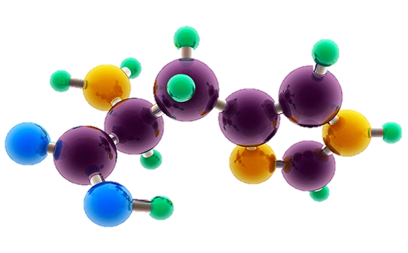
AP Chemistry
Exam Review

Slide 2
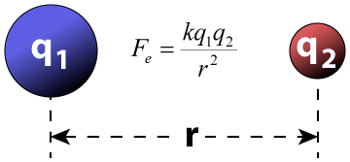
Big Idea #1
Properties of Matter

Slide 3
Ratio of Masses in a Pure Sample
All elements and molecules are made up of atoms
Substances with the same atomic makeup will have same average masses
The ratio of masses of the same substance is independent of size of the substance
Molecules with the same atomic makeup (ex: H₂O) will have the same ratio of average atomic masses
  H₂O₂ ratio would be different than H₂O due to the different chemical makeup
H₂O
Video
108 g/mol
Click reveals answer and explanation.
LO 1.1: Justify the observation that the ratio of the masses of the constituent elements in any pure sample of that compound is always identical on the basis of the atomic molecular theory.

Slide 4
Composition of Pure Substances and/or Mixtures
Percent mass can be used to determine the composition of a substance
  % mass can also be used to find the empirical formula
The empirical formula is the simplest formula of a substance
  It is a ratio between the moles of each element in the substance
  Quick steps to solve!
    % to mass, mass to moles, divide by the smallest and multiply ‘til whole!)
  The molecular formula is the actual formula of a substance
    It is a whole number multiple of the empirical formula
Video
Click reveals answer and explanation.
LO 1.2: Select and apply mathematical routines to mass data to identify or infer the composition of pure substances and/or mixtures.

Slide 5
Identifying Purity of a Substance
Impurities in a substance can change the percent composition by mass
If more of a certain element is added from an impurity, then the percent mass of that element will increase and vice versa
When heating a hydrate, the substance is heated several times to ensure the water is driven off
  Then you are simply left with the pure substance and no excess water
The mass percent of oxygen in pure glucose, C₆H₁₂O₆ is 53.3 percent. A chemist analyzes a sample of glucose that contains impurities and determines that the mass percent of oxygen is 49.7 percent. Which of the follow impurities could account for the low mass percent of oxygen in the sample?
n-eicosane (C₂₀H₄₂)
ribose C₅H₁₀O₅
fructose, C₆H₁₂O₆
sucrose C₁₂H₂₂O₁₁
a. Is the only option with a %O lower than 49.7%
LO 1.3: The student is able to select and apply mathematical relationships to mass data in order to justify a claim regarding the identity and/or estimated purity of a substance.

Slide 6
Mole Calculations
1 mole = 6.02 x 10²³ representative particles
1 mole = molar mass of a substance
1 mole = 22.4 L of a gas at STP
Video
Click reveals answer and explanation.
LO 1.4: The student is able to connect the number of particles, moles, mass and volume of substances to one another, both qualitatively and quantitatively.

Slide 7
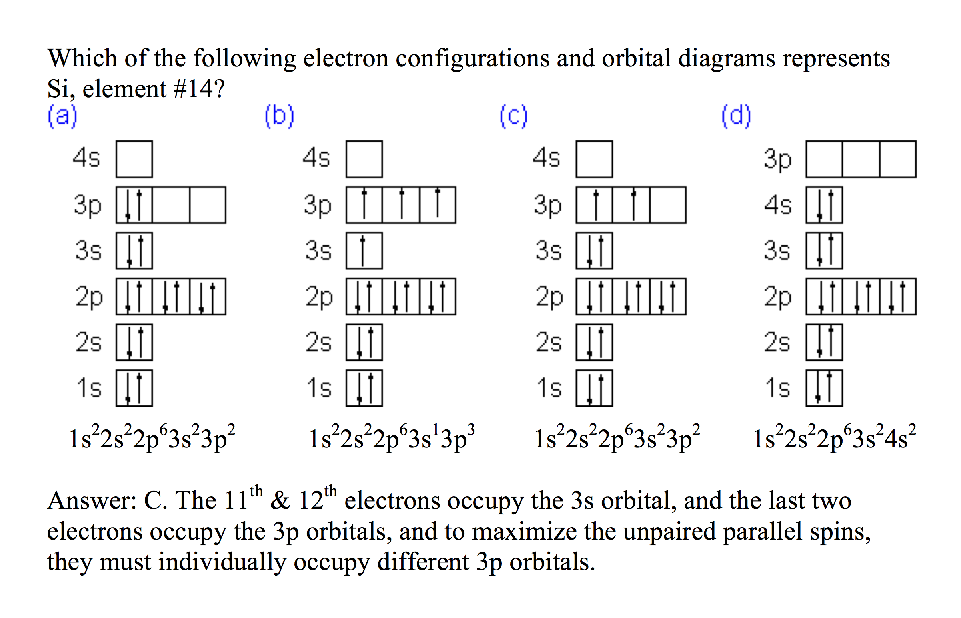
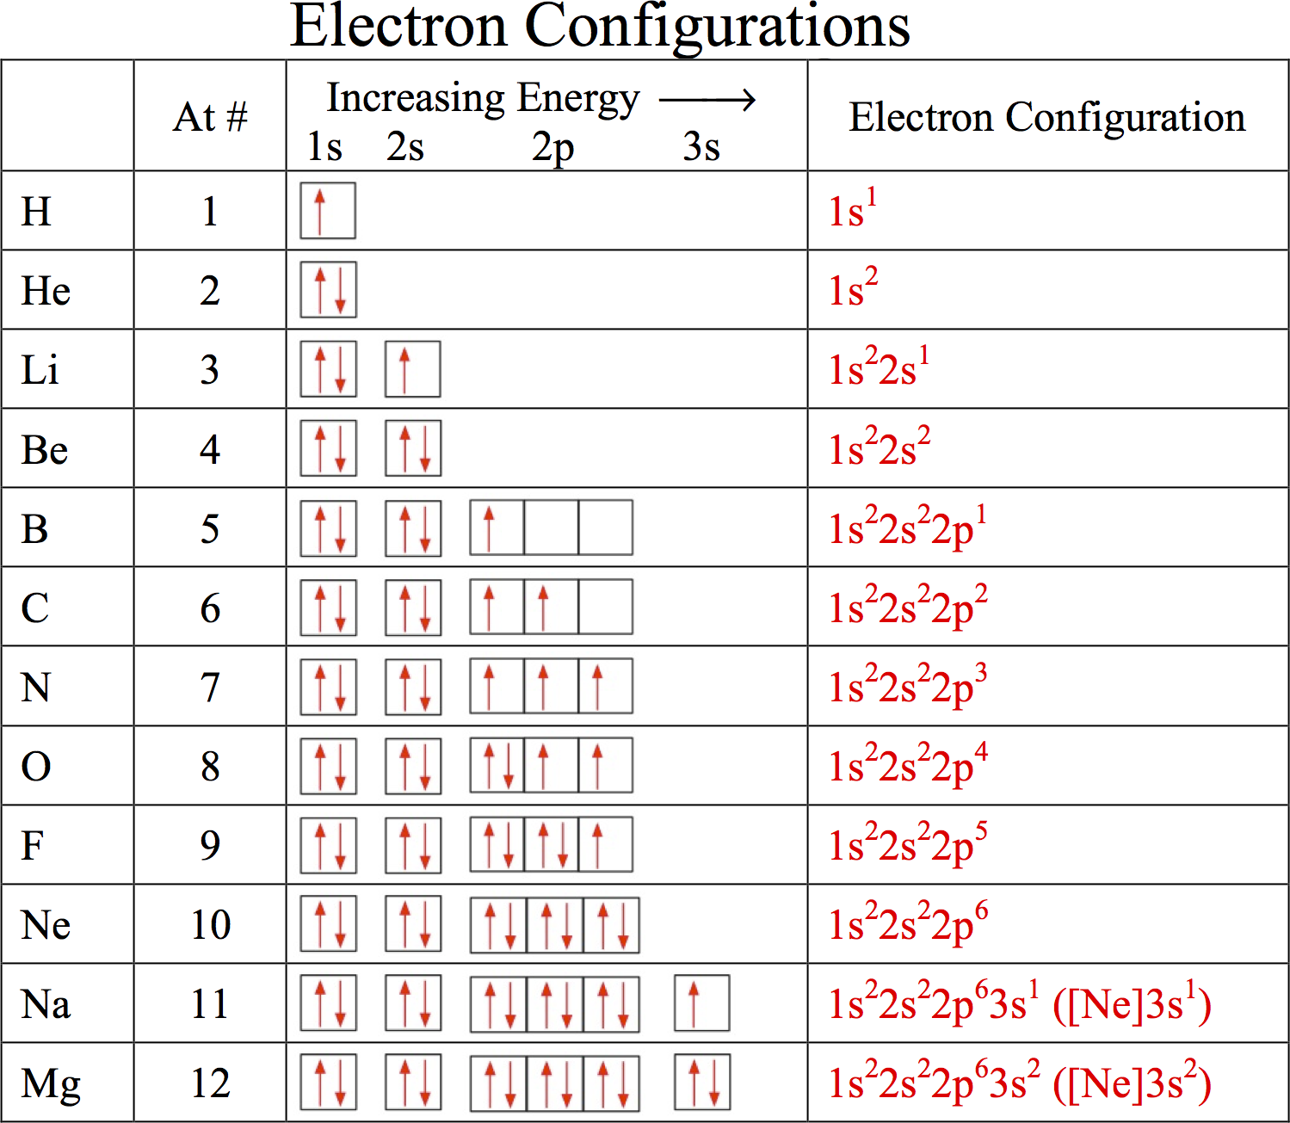
Electronic Structure of the Atom: Electron Configurations
Electrons in occupy orbitals whose energy level depends on the nuclear charge and average distance to the nucleus
Electron configurations & orbital diagrams indicate the arrangement of electrons with the lowest energy (most stable):
  Electrons occupy lowest available energy levels
  A maximum of two electrons may occupy an energy level
    Each must have opposite spin (±½)
  In orbitals of equal energy, electrons maximize parallel unpaired spins
Click reveals answer and explanation.
LO 1.5: The student is able to explain the distribution of electrons in an atom or ion based upon data.

Slide 8
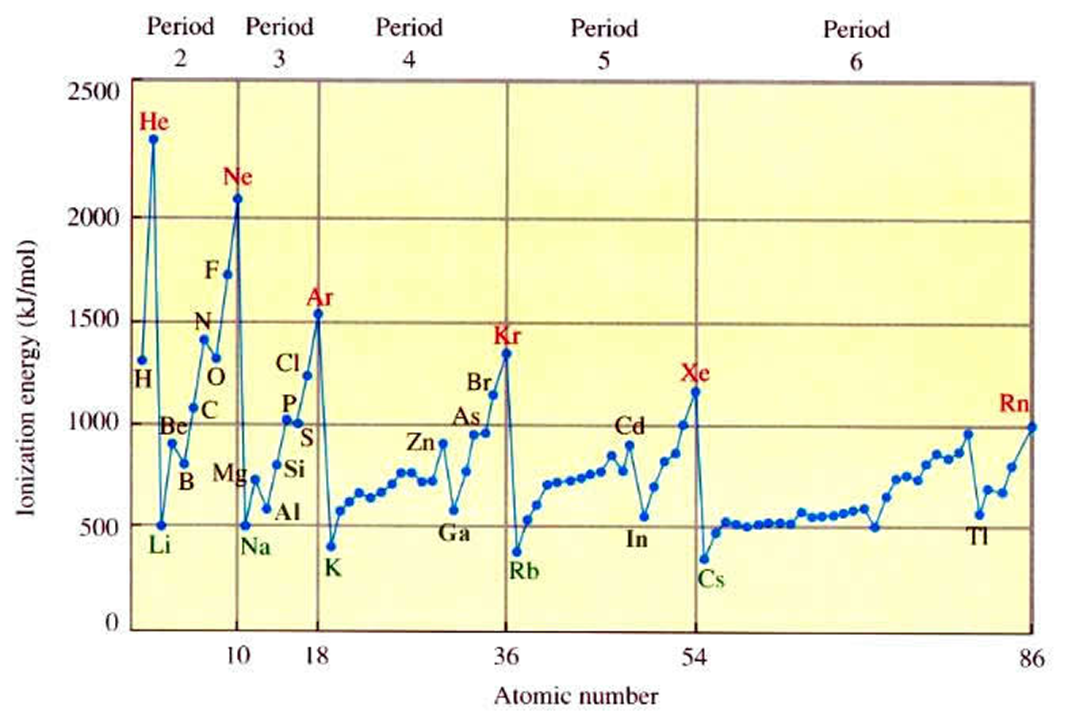
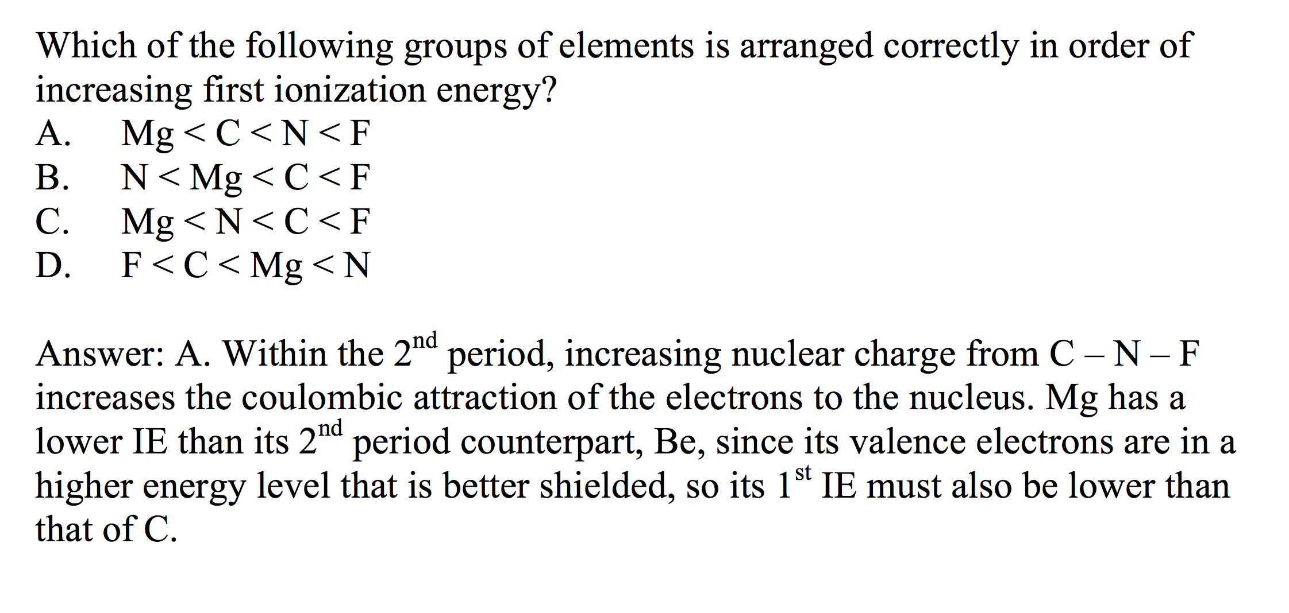
Electronic Structure of the Atom:
1st Ionization Energy
1st Ionization Energy Energy (IE) indicates the strength of the coulombic attraction of the outermost, easiest to remove, electron to the nucleus:
X(g) + IE X⁺(g) + e–
  1st IE generally increases across a period and decreases down a group
    IE generally increases as #protons increases in same energy level
    IE decreases as e– in higher energy level: increased shielding, e– farther from nucleus
Click reveals answer and explanation.
LO 1.6: The student is able to analyze data relating to electron energies for patterns and relationships.

Slide 9
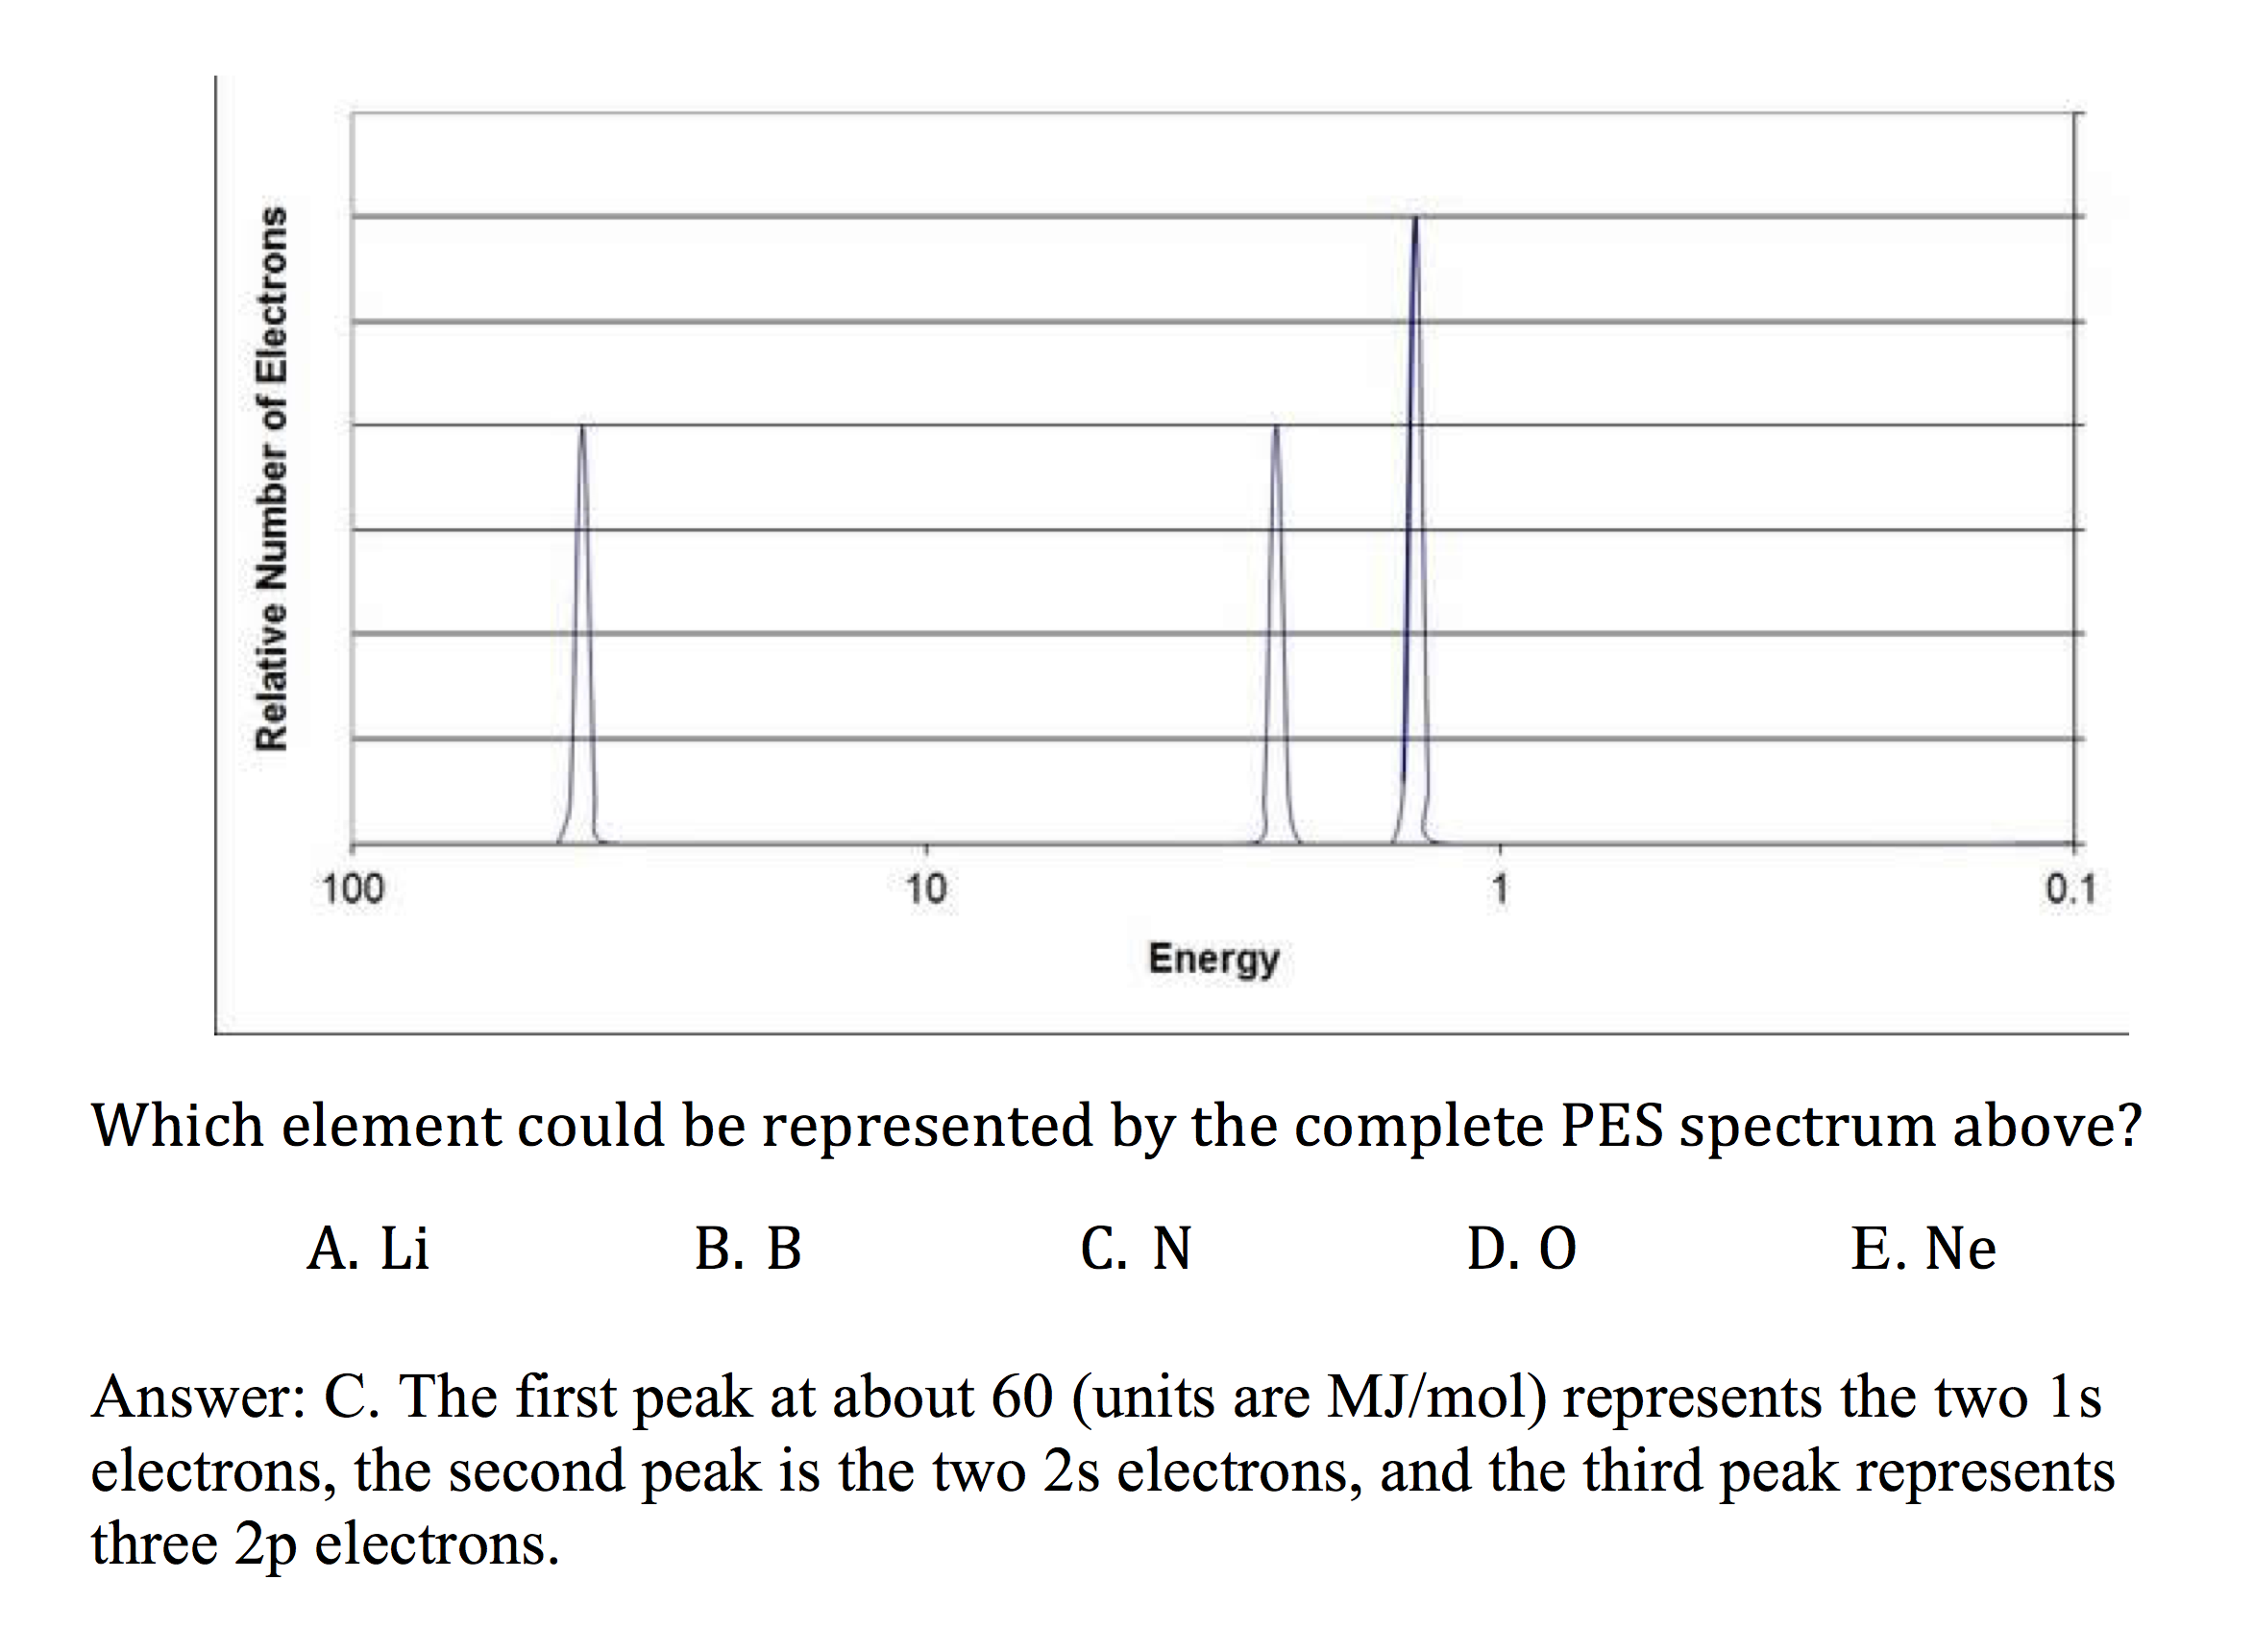
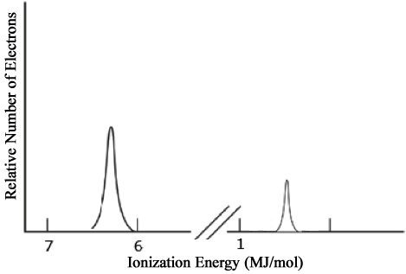
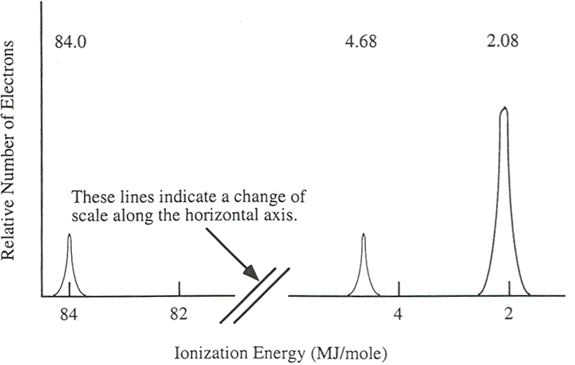
Electronic Structure of the Atom: Photoelectron Spectroscopy (PES)
Li
PES uses high-energy (X-ray) photon to excite random e– from atom
KE of ejected electron indicates binding energy (coulombic attraction) to nucleus:
BE = hϖ_{photon} – KE
Direct measurement of energy and number of each electron
  Lower energy levels have higher BE
  Signal size proportional to number of e– in energy level
Elements with more protons have stronger coulombic attraction, higher BE at each energy level
1s²
2s¹
Ne
2p⁶
1s²
2s²
Click reveals answer and explanation.
LO 1.7: The student is able to describe the electronic structure of the atom, using PES data, ionization energy data, and/or Coulomb’s law to construct explanations of how the energies of electrons within shells in atoms vary.

Slide 10
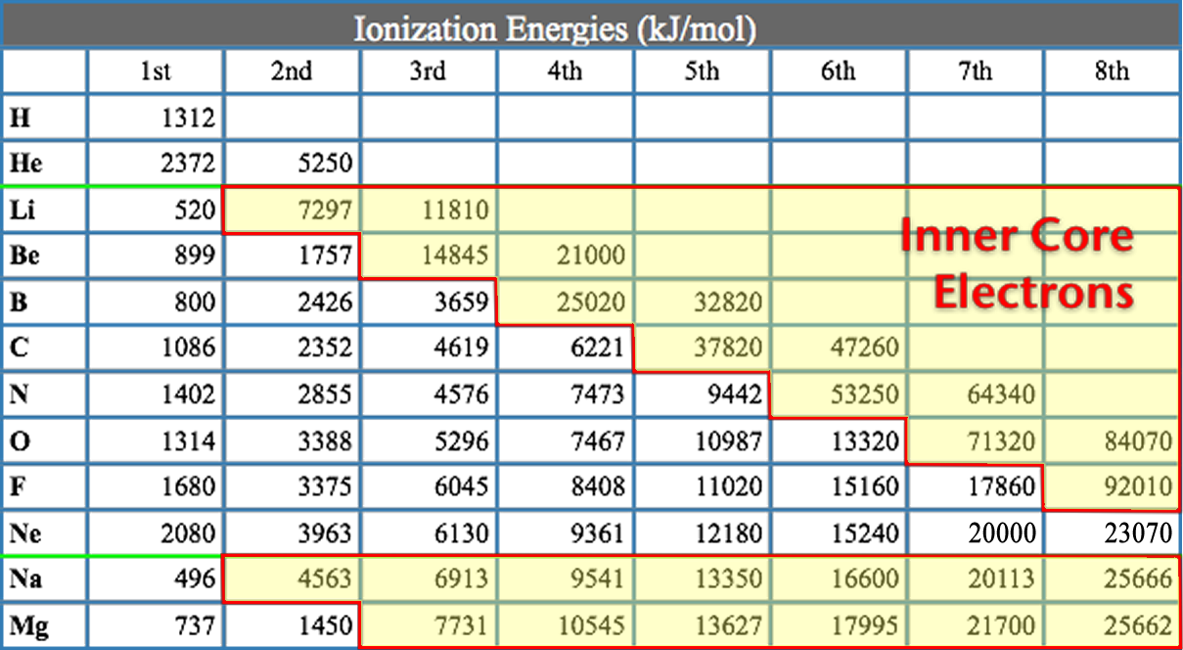
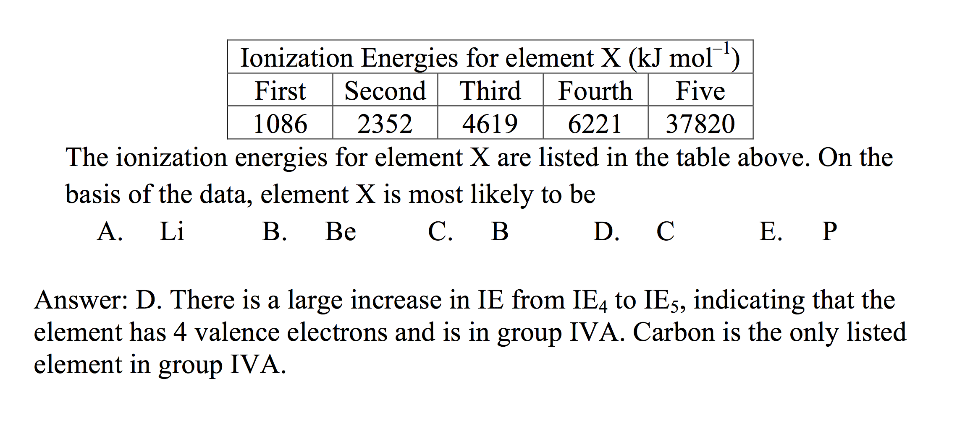
Electronic Structure of the Atom: Higher Ionization Energies
2nd & subsequent IE’s increase as coulombic attraction of remaining e–’s to nucleus increases
X⁺ + IE X²⁺ + e–
X²⁺ + IE X³⁺ + e–
  Large jump in IE when removing less-shielded core electrons
Click reveals answer and explanation.
LO 1.8: The student is able to explain the distribution of electrons using Coulomb’s law to analyze measured energies.

Slide 11
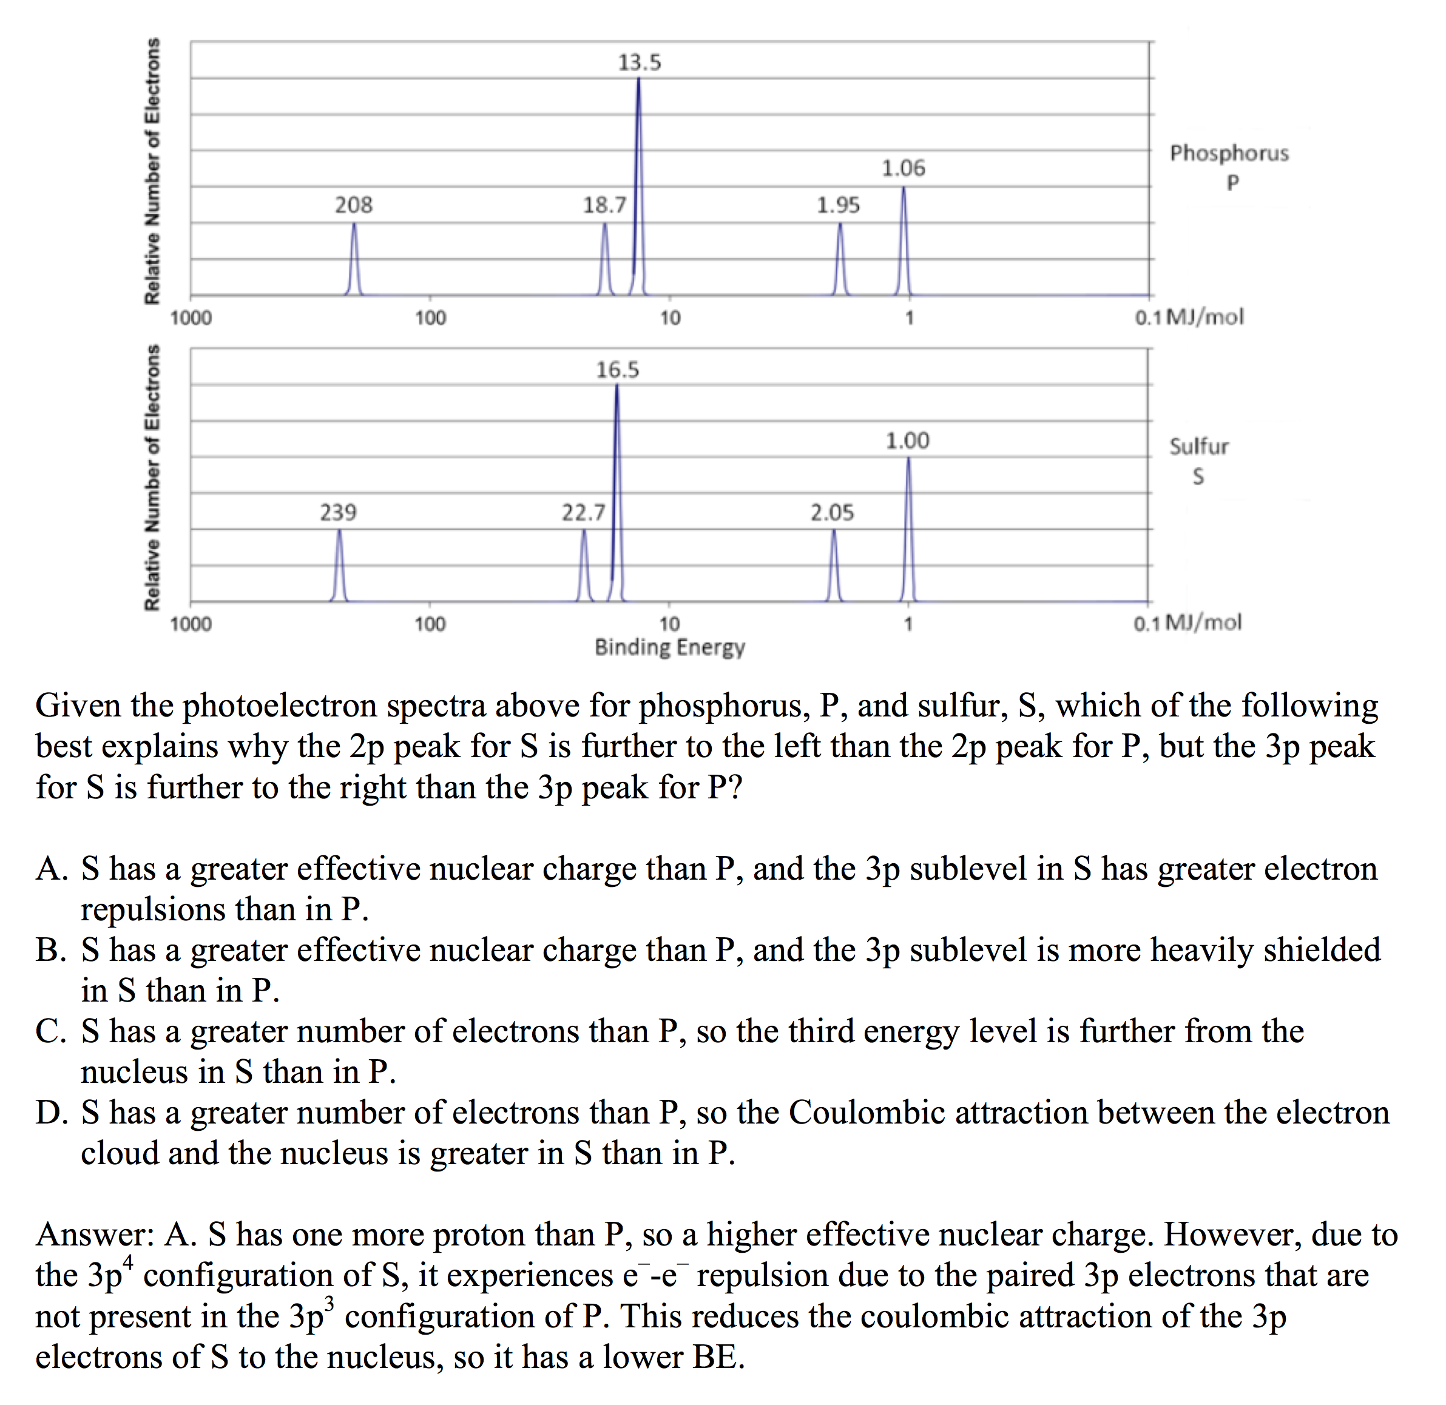
Electronic Structure of the Atom:
1st Ionization Energy Irregularities
1st Ionization Energy Energy (IE) decreases from Be to B and Mg to Al
  Electron in 2p or 3p shielded by 2s² or 3s² electrons, decreasing coulombic attraction despite additional proton in nucleus.
  Same effect seen in 3d¹⁰-4p, 4d¹⁰-5p and 5d¹⁰-6p
1st Ionization Energy decreases from N to O and P to S
  np⁴ contains first paired p electrons, e–-e– repulsion decreases coulombic attraction despite additional proton
Click reveals answer and explanation.
LO 1.8: The student is able to explain the distribution of electrons using Coulomb’s law to analyze measured energies.

Slide 12
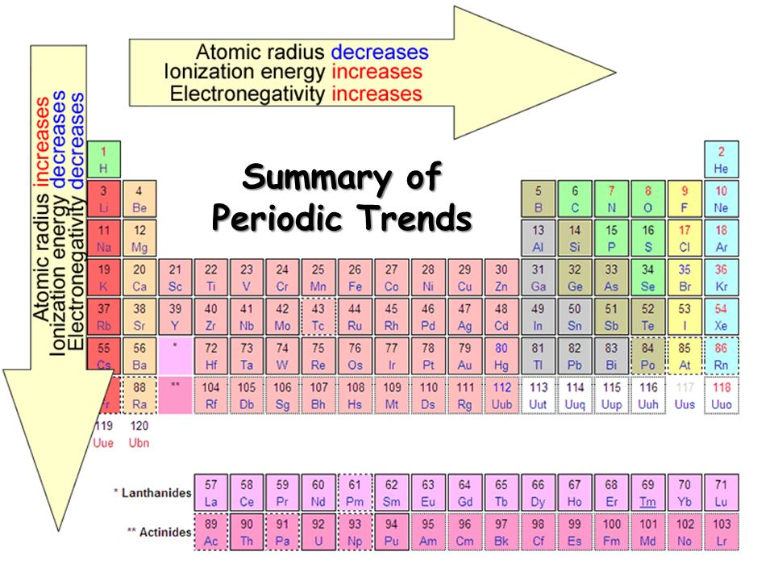
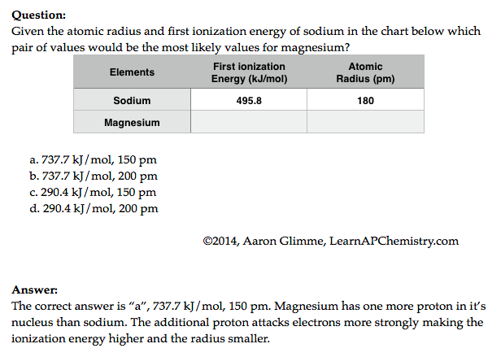
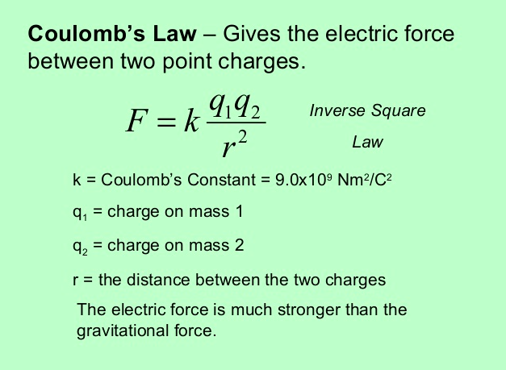
Predictions with Periodic Trends
Video
The following explains these trends:
  Electrons attracted to the protons in the nucleus of an atom
    So the closer an electron is to a nucleus, the more strongly it is attracted (Coulomb’s law)
    The more protons in a nucleus (effective nuclear force), the more strongly it attracts electrons
  Electrons are repelled by other electrons in an atom. If valence electrons are shielded from nucleus by other electrons, you will have less attraction of the nucleus (again Coulomb’s law-greater the atomic radius, the greater the distance)
Click reveals answer and explanation.
its
attracts
L.O. 1.9 The student is able to predict and/or justify trends in atomic properties based on location on periodic table and/or the shell model

Slide 13

Chemical Reactivity
Using Trends
Nonmetals have higher electronegativities than metals --> causes the formation of ionic solids
Compounds formed between nonmetals are molecular
  Usually gases, liquids, or volatile solids at room temperature
Elements in the 3rd period and below can accommodate a larger number of bonds
The first element in a group (upper most element of a group) forms pi bonds more easily (most significant in 2nd row, non-metals)
  Accounts for stronger bonds in molecules containing these elements
  Major factor in determining the structures of compounds formed from these elements
Elements in periods 3-6 tend to form only single bonds
Reactivity tends to increase as you go down a group for metals and up a group for non-metals.
46) Of the elements below, __________ is the most chemically reactive.
A) sodium
B) barium
C) calcium
D) cesium
E) magnesium
L.O. 1.10: Students can justify with evidence the arrangement of the periodic table and can apply periodic properties to chemical reactivity

Slide 14
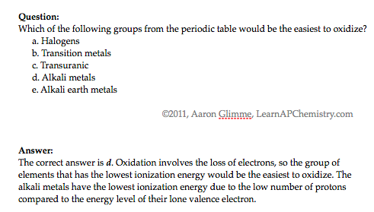
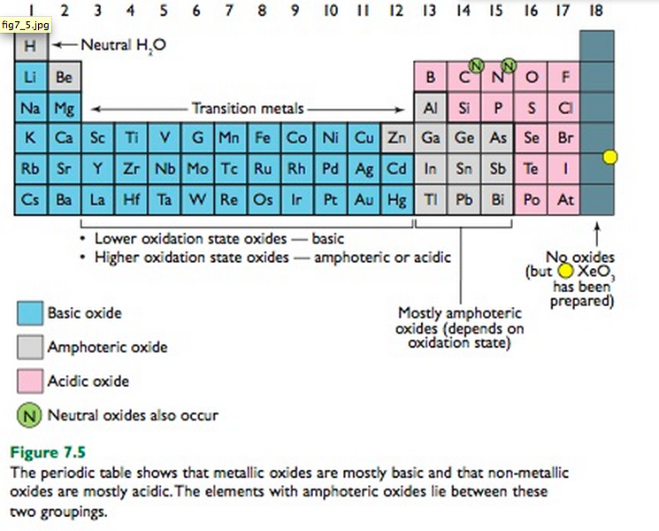
Chemical Properties within a Group and across a Period
Group 1 metals more
reactive than group 2
metals
Reactivity increases as you go down a group
Metals on left form basic oxides
  Ex. Na₂O + H₂O → 2 NaOH
Nonmetals on right form form acidic oxides
  Ex. SO₃ + H₂O → H₂SO₄
Elements in the middle, like Al, Ga, etc can behave amphoterically
If SiO₂ can be a ceramic then SnO₂ may be as well since both in the same group
Video
Click reveals answer and explanation.
its
attracts
LO 1.11: Analyze data, based on periodicity & properties of binary compounds, to identify patterns & generate hypotheses related to molecular design of compounds

Slide 15
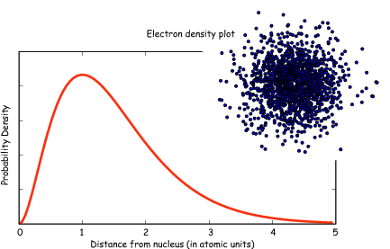
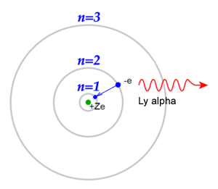
Classic Shell Model of Atom vs
Quantum Mechanical Model
Quantum Mechanical Model
Developed by Schrodinger and the position of an electron is now
represented by a wave equation
Most probable place of finding an electron is called an ORBITAL (90% probability)
Each orbital can only hold 2 electrons with opposing spins (S, P, D & F orbitals)
Evidence for this theory:
Work of DeBroglie and PLanck that electron had wavelike characteristics
Heisenberg Uncertainty Principle - impossible to predict exact location of electron- contradicted Bohr
This new evidence caused the Shell Theory to be replaced by the Quantum Mechanical Model of the atom
Shell Model - Bohr
Developed by Schrodinger and the position of an electron is now
represented by a wave equation
Most probable place of finding an electron is called an ORBITAL (90% probability)
Each orbital can only hold 2 electrons with opposing spins (S, P, D & F orbitals)
Evidence for this theory:
Work of DeBroglie and PLanck that electron had wavelike characteristics
Heisenberg Uncertainty Principle - impossible to predict exact location of electron- contradicted Bohr
This new evidence caused the Shell Theory to be replaced by the Quantum Mechanical Model of the atom
Video
LO 1.12: Explain why data suggests (or not) the need to refine a model from a classical shell model with the quantum mechanical model

Slide 16
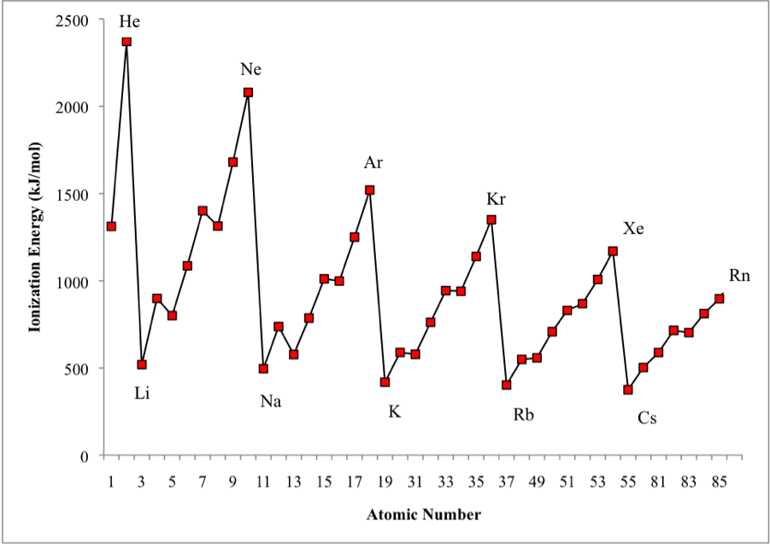
Shell Model is consistent with Ionization Energy Data
The patterns shown by
the IE graph can be
explained by Coulomb’s law
As atomic number increases, would expect the ionization energy to constantly increase
Graph shows that this is NOT observed. WHY NOT?
The data implies that a shell becomes full at the end of each period
Therefore the next electron added must be in a new shell farther away from the nucleus.
This is supported by the fact that the ionization energy drops despite the addition positive charge in the nucleus
LO: 1.13 Given information about a particular model of the atom, the student is able to determine if the model is consistent with specified evidence

Slide 17
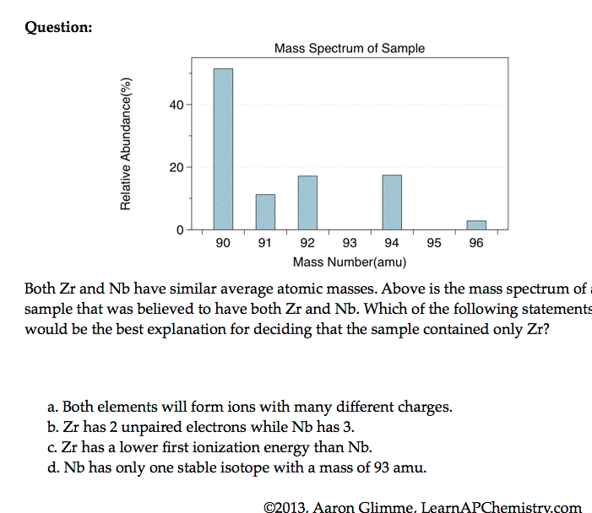
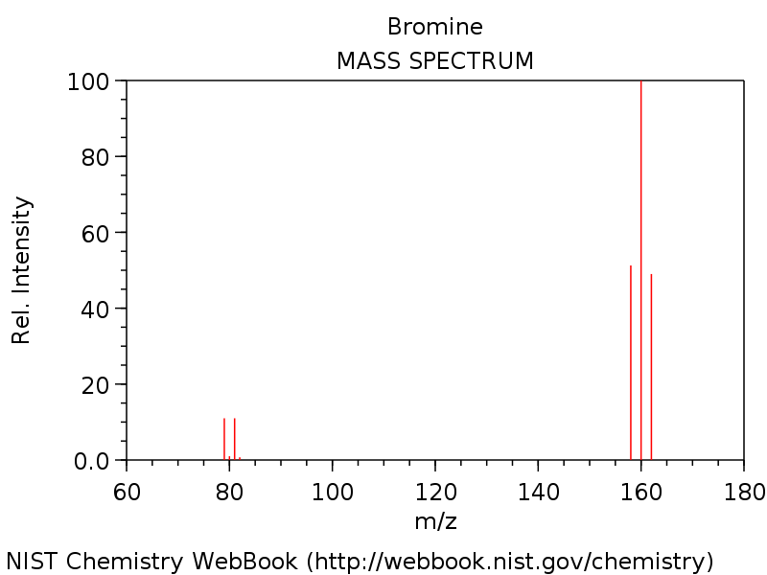
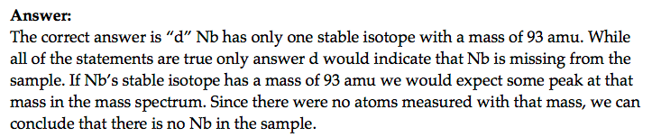

Mass Spectrometry - evidence for isotopes
Source
Mass spectrometry showed
that elements have isotopes
This contradicted Dalton’s early model of the atom which stated that all atoms of an element are identical
3 Br₂ & two Br isotopes shown in diagram
The average atomic mass of the element can be estimated from mass spectroscopy
Video
LO 1.14: The student is able to use the data from mass spectrometry to identify the elements and the masses of individual atoms of a specific element

Slide 18
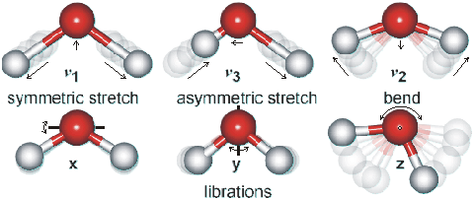
Using Spectroscopy to measure properties associated with vibrational or electronic motions of molecules
IR Video
UV Video
IR Radiation - detects different types of bonds by analyzing molecular vibrations
UV or X-Ray Radiation
Photoelectron Spectroscopy(PES)
Causes electron transitions
Transitions provides info on
electron configurations
LO: 1.15 Justify the selection of a particular type of spectroscopy to measure properties associated with vibrational or electronic motions of molecules

Slide 19
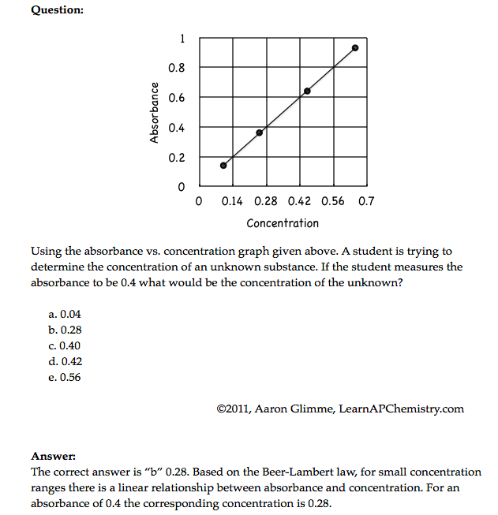
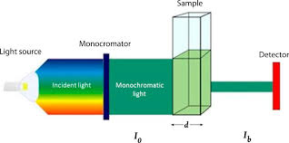
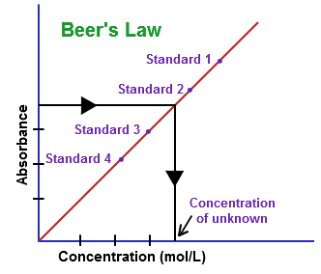
Beer-Lambert Law - used to measure the concentration of colored solutions
A = abc
A = absorbance
a = molar absorptivity (constant for material being tested)
b = path length (cuvette = 1 cm)
c = concentration
Taken at fixed wavelength
Click reveals answer and explanation.
LO1.16: Design and/or interpret the results of an experiment regarding the absorption of light to determine the concentration of an absorbing species in solution

Slide 20
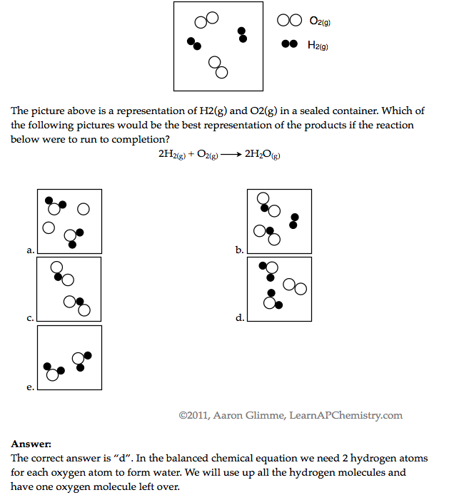
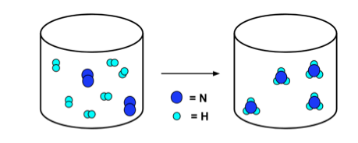
Law of Conservation of Mass
N₂ + 3H₂ → 2NH₃
Click reveals answer and explanation.
LO1.17: Express the law of conservation of mass quantitatively and qualitatively using symbolic representations and particulate drawings

Slide 21
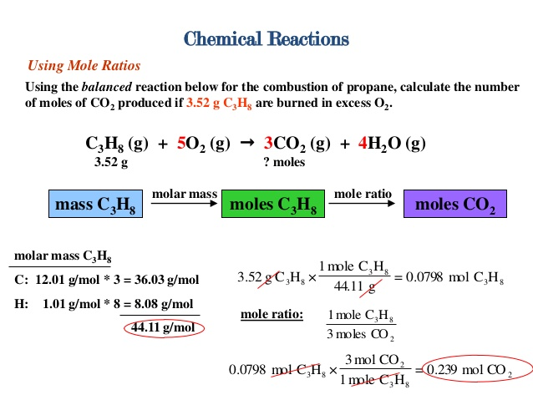
Use Mole Ratio in balanced equation to calculate moles of unknown substance
LO1.18: Apply the conservation of atoms to the rearrangement of atoms in various processes.

Slide 22
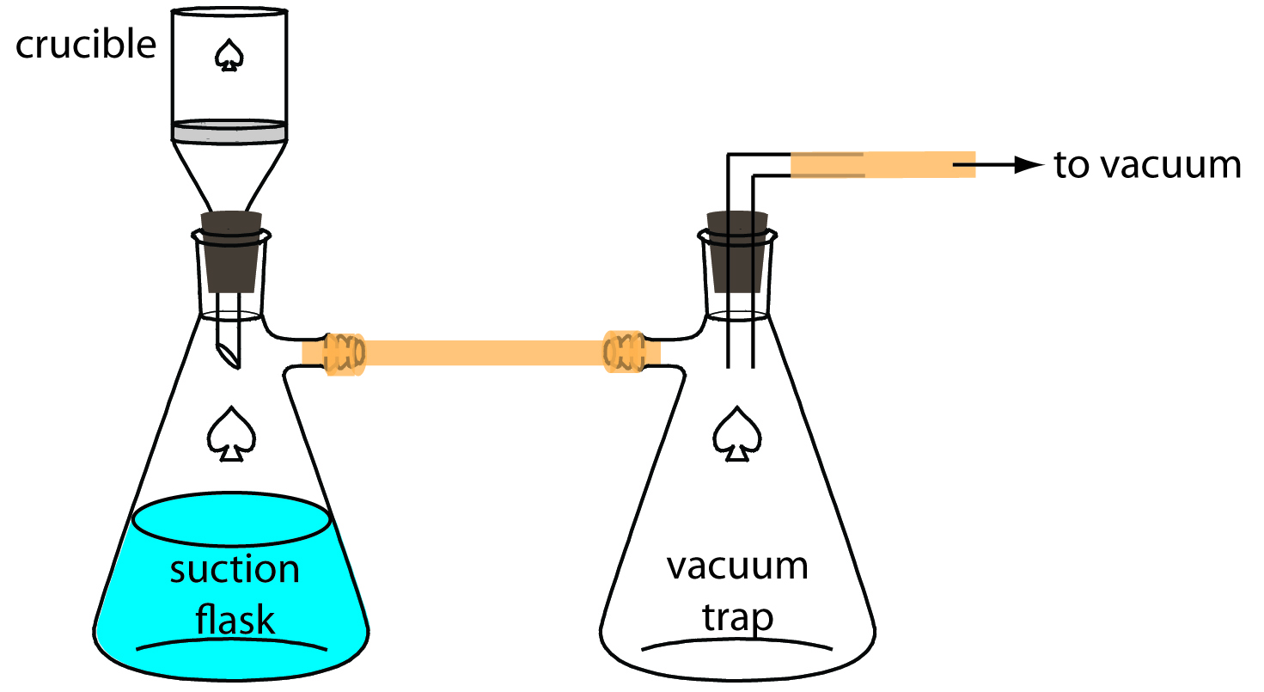
Gravimetric Analysis
Buchner Filtration Apparatus
How much lead
(Pb²⁺) in water?
Pb²⁺(aq) + 2Cl⁻(aq) → PbCl₂ (s)
By adding excess Cl- to the sample, all of the Pb²⁺ will precipitate as PbCl₂
Solid product is filtered using a Buchner Filter and then dried to remove all water
Mass of PbCl₂is then determined
This can be used to calculate the original amount of lead in the water
LO 1.19: Design and/or interpret data from, an experiment that uses gravimetric analysis to determine the the concentration of an analyte in a solution.

Slide 23
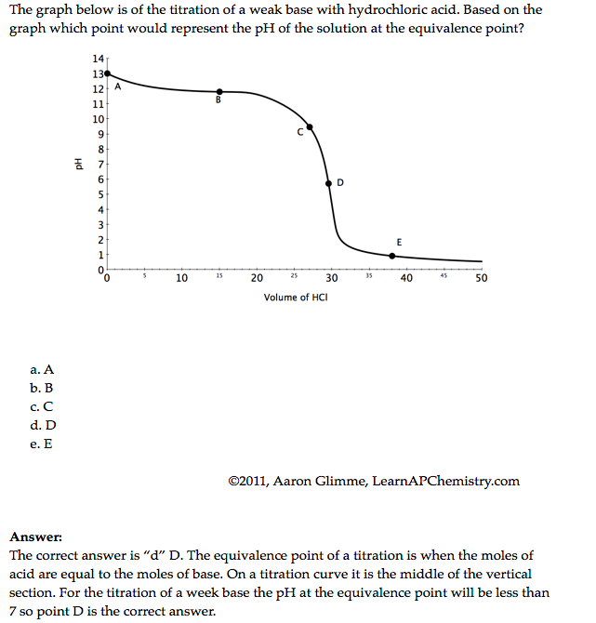
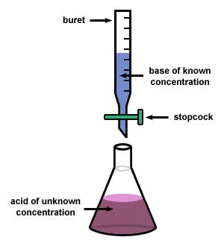
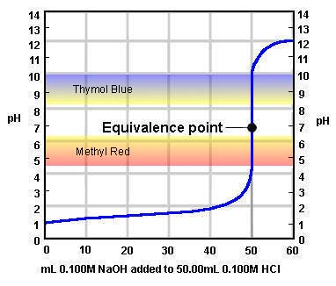
Using titrations to determine concentration of an analyte
At the equivalence point, the stoichiometric molar ratio is reached
Click reveals answer and explanation.
LO1.20: Design and/or interpret data from an experiment that uses titration to determine the concentration of an analyte in a solution.

Slide 24
Big Idea #2
Properties of Matter

Slide 25
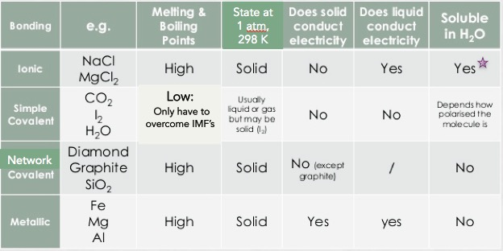
Properties Based on Bonding
Visit the Virtual Lab to explore properties based on bond type (click on perform)
Not all ionic compounds are soluble, but those containing ammonium, nitrate, alkali metals, and halogens (except bonded to Ag, Hg and Pb) are typically
LO 2.1: Students can predict properties of substances based on their chemical formulas, and provide explanations of their properties based on particle views

Slide 26
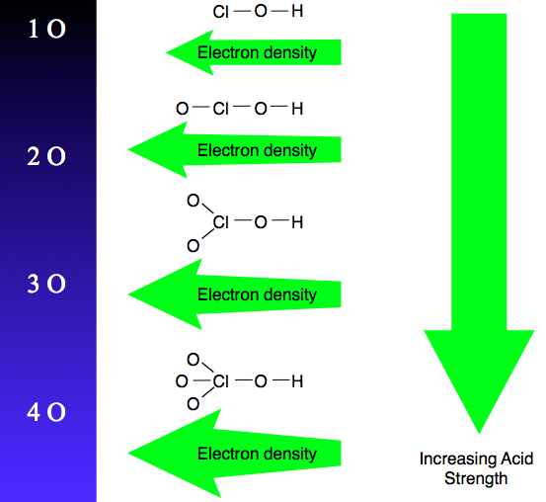
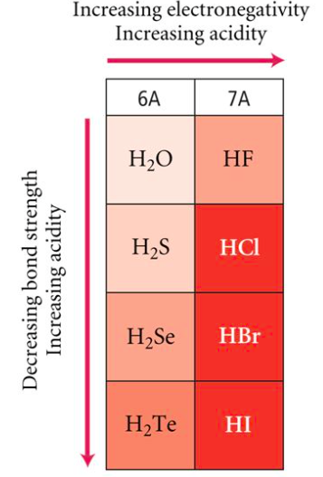
Oxyacid Strength
Binary Acid Strength
Source
LO 2.2: student is able to explain the
relative strengths of acids and bases based on
structure, IMF’s, & equilibrium.
Reading
The increased number of oxygen atoms pulls negative charge away from the O-H bond, weakening the attraction of the proton for the electron pair and thus strengthening the acid.
The greater the size of the negative ion, the weaker its attraction for the proton, and so the stronger the acid, and the weaker the conjugate base. HI is the strongest binary acid.

Slide 27
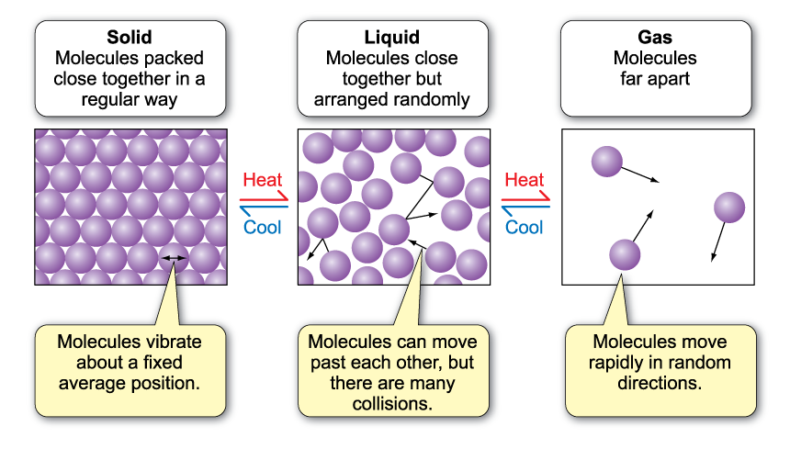
Behaviors of Solids, Liquids, and Gases
LO 2.3: The student is able to use particulate models to reason about observed differences between solid and liquid phases and among solid and liquid materials.

Slide 28
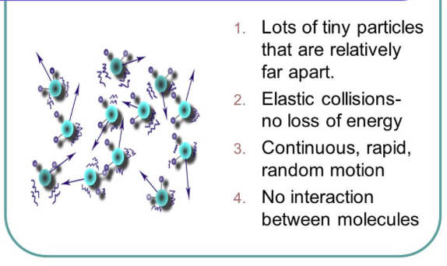
Kinetic
Molecular
Theory
(KMT)
Source
IF the temperature is not changed, no matter what else is listed in the problem, the average kinetic energy of a gas does not change. That is the definition of temperature!
All gases begin to act non-ideally (aka real) when they are at low temperatures and/or high pressures because these conditions increase particle interactions
Under the same conditions, the stronger the intermolecular attractions between gas particles, the LESS ideal the behavior of the gas
LO 2.4: The student is able to use KMT and IMF’s to make predictions about the macroscopic properties of gases, including both ideal and non-ideal behaviors

Slide 29
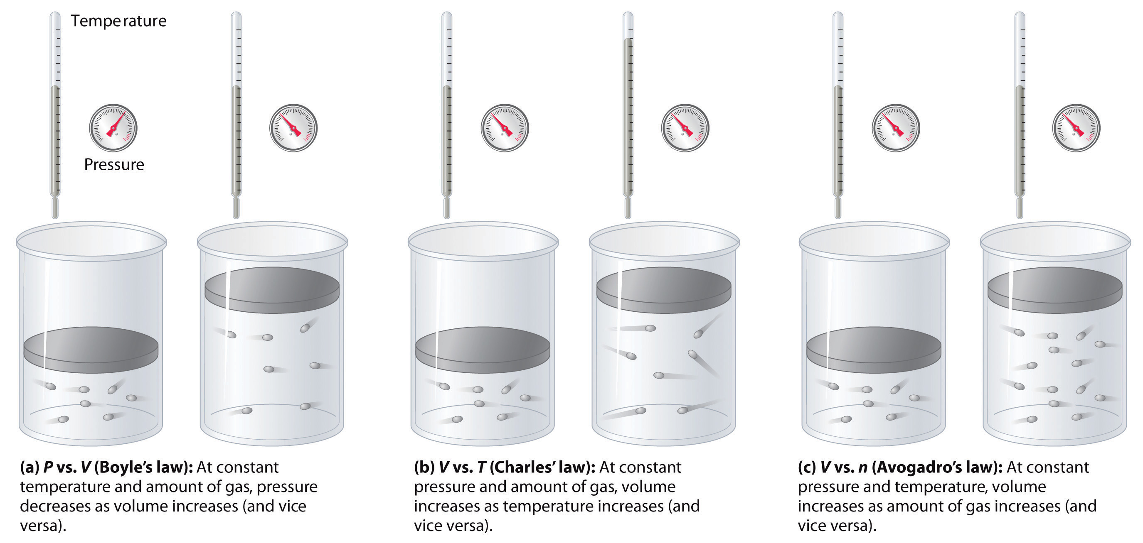
Properties of a Gas - Factors
Source
Don’t worry about individual gas law names, but do worry about the effect of changing moles, pressure and temperature on a sample of gas
Virtual Lab
LO 2.5: Refine multiple representations of a sample of matter in the gas phase to accurately represent the effect of changes in macroscopic properties on the sample

Slide 30
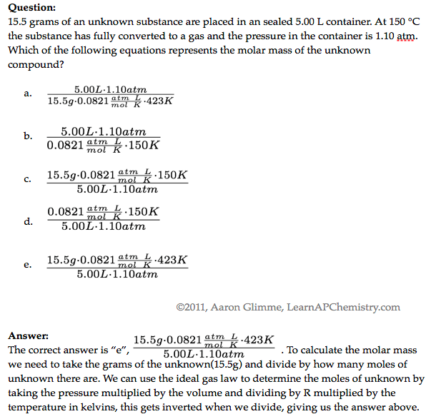

The Ideal Gas Law
LO 2.6: The student can apply mathematical relationships or estimation to determine macroscopic variables for ideal gases
Click reveals answer and explanation.

Slide 31
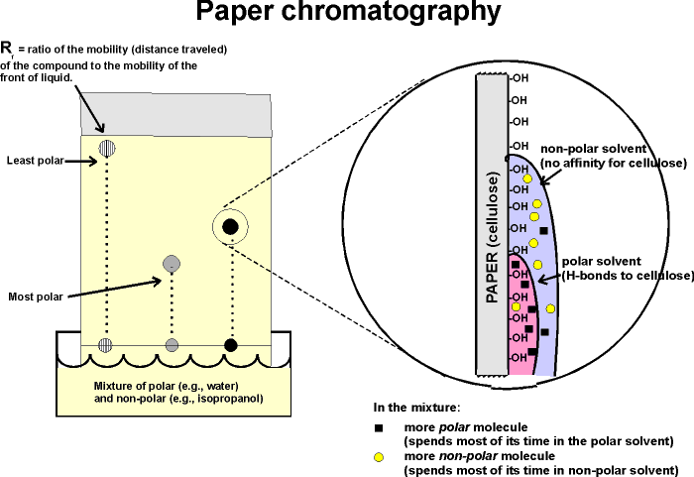
Chromatography
LO 2.7: The student is able to explain how solutes can be separated by chromatography based on intermolecular interactions.

Slide 32
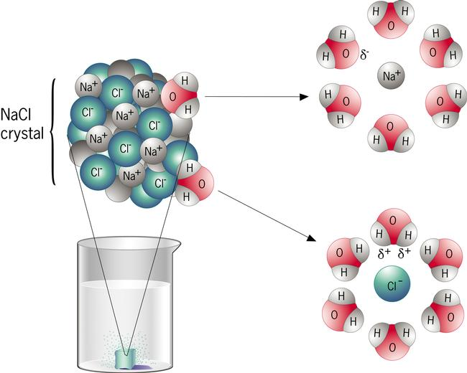
Dissolving/Dissociation: Solute and Solvent
When drawing solute ions:
pay attention to size (Na⁺ is smaller than Cl⁻)
Draw charges on ion, but not on water
draw at least 3 water molecules around each
the negative dipole (oxygen side) points toward cation and the postive dipoles (H side) points towards the anion
LO 2.8: The student can draw and/or interpret representations of solutions that show the interactions between the solute and solvent.

Slide 33
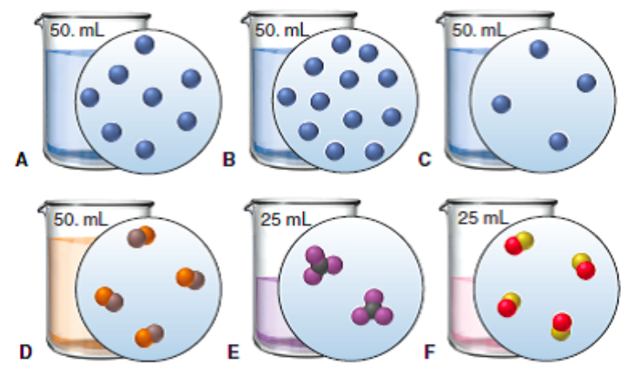
Molarity and Particle Views
Source
Video
QUESTION: Rank the six solutions above in order of increasing molarity. Pay attention to volume, and some have equal concentration
C,D, and E (tied); A and F (tied); most concentrated is B
Click reveals answer
LO 2.9: The student is able to create or interpret representations that link the concept of molarity with particle views of solutions

Slide 34
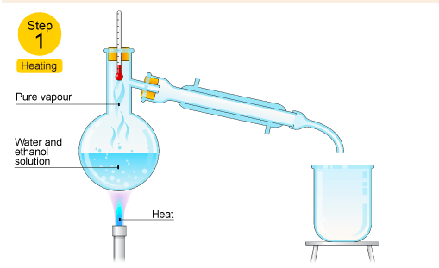
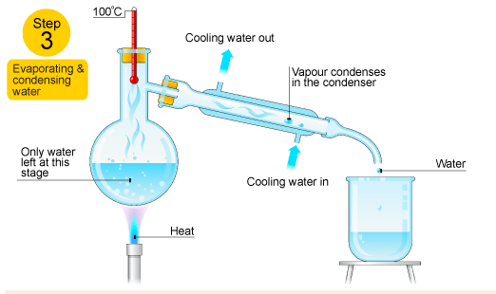
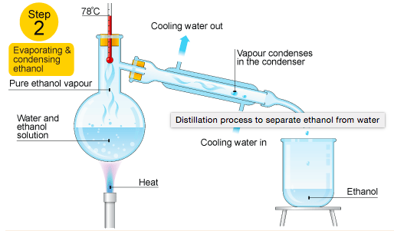


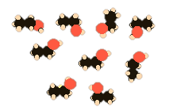
Distillation to Separate Solutions
Source
Video
In the diagram above, ethanol has lower IMF’s and a resulting lower boiling point than water, so it can be heated, vaporized and condensed easily.
Ethanol hydrogen bonds as water does and is polar, but part of the ethanol has only weaker LDF’s because it’s nonpolar resulting in a lower boiling point
LO 2.10: Design/interpret the results of filtration, paper/column chromatography, or distillation in terms of the relative strength of interactions among the components.

Slide 35
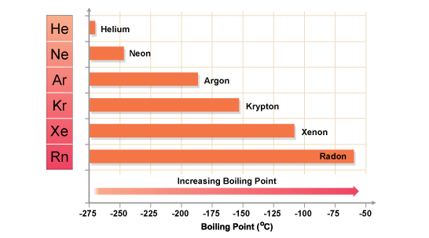
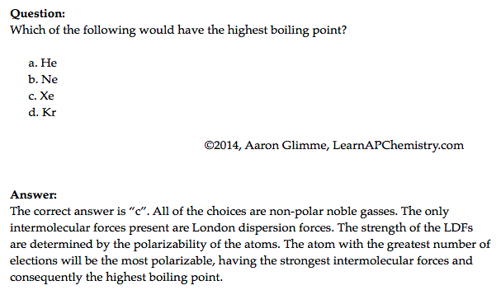
London Dispersion Forces and Noble and Nonpolar Gases
Source
This answer is VITAL! Remember with increased number of ELECTRONS a particle becomes more polarizable, not with increased mass!
Video
Click reveals answer and explanation.
LO 2.11: The student is able to explain the trends in properties/predict properties of samples consisting of particles with no permanent dipole on the basis of LDF’s.

Slide 36

Deviations from Ideal Gas Behavior
Source
Video
When watching the video, don’t concern yourself with Van der Walls – AP Exam focuses on LDF’s instead
Click reveals answer and explanation.
LO 2.12: The student can qualitatively analyze data regarding real gases to identify deviations from ideal behavior and relate these to molecular interactions

Slide 37


Hydrogen Bonding
Source
Hydrogen bonding is seen in the following molecules: water, DNA, ammonia, HF, and alcohols. H-bonding is an attraction or force not a true intramolecular bond.
Hydrogen bonds are like a sandwich with N, O, and/or F as the bread. H will be in a intramolecular (same molecule) bond with one N, O, and/or F and have an intermolecular attraction (different molecule) with the other.
Video
Remember this tip:
hydrogen bonds just wanna have FON
LO 2.13: The student is able to describe the relationships between the structural features of polar molecules and the forces of attraction between the particles.

Slide 38

Coulomb’s Law and Solubility
Source
Ionic compounds can dissolve in polar liquids like water because the ions are attracted to either the positive or negative part of the molecule.
There is a sort of tug-of-war involved with species dissolved in water. The water pulls individual ions away from the solid. The solid is pulling individual ions back out of the water. There exists an equilibrium based on how strongly the water attracts the ions, versus how strong the ionic solid attracts the ions.
We can predict the degree of solubility in water for different ionic compounds using Coulomb's law. The smaller the ions, the closer together they are, and the harder it is for the water molecules to pull the ions away from each other. The greater the charge of the ions, the harder it is for the water to pull them away as well.
Video
QUESTION: Predict which of the following pairs should be more soluble in water, based on Coulombic attraction.
LiF or NaF
NaF or KF
BeO or LiF
LO 2.14: Apply Coulomb’s law to describe the interactions of ions, & the attractions of ions/solvents to explain the factors that contribute to solubility of ionic compounds.

Slide 39

Entropy in Solutions
Source
Video
Do NOT say “like dissolves like.” You’ll, like... get no points.
DO refer to LDF’s, hydrogen bonding and dipole-dipole interactions
Generally speaking. There are exceptions
LO 2.15: Explain observations of the solubility of ionic solids/molecules in water and other solvents on the basis of particle views that include IMF’s and entropic effects.

Slide 40


Physical Properties and IMF’s
Source
Video
Hg
Click reveals answer and explanation.
LO 2.16: Explain the properties (phase, vapor pressure, viscosity, etc.) of small and large molecular compounds in terms of the strengths and types of IMF’s.

Slide 41

Bonding and Electronegativity
Source
Differences in electronegativities lead to different types of bonding*:
0.0 – 0.4: Bond is generally considered nonpolar
0.5 – 1.7: Bond is generally considered polar
> 1.7: Bond is generally considered ionic
Video
Electronegativities are assigned values and are relative to fluorine. Electronegativity is a function of shielding / effective nuclear charge.
*Values presented are one possibility – other scales exist.
LO 2.17: The student can predict the type of bonding present between two atoms in a binary compound based on position in the periodic table and the electronegativity of the elements.

Slide 42

Ranking Bond Polarity
Source
Video
LO 2.18: The student is able to rank and justify the on the ranking of bond polarity on the basis of the locations of the bonded atoms in the periodic table.

Slide 43


Ionic Substances and their Properties
Source
Ionic compounds are brittle. As the crystal structure is struck, the ions become displaced. The displaced ions will repel like charges and fracture.
Video
LO 2.19: The student can create visual representations of ionic substances that connect the microscopic structure to macroscopic properties and/or use representations to connect microscopic structure to macroscopic properties (e.g., boiling point, solubility, hardness, brittleness, low volatility, lack of malleability, ductility, or conductivity).

Slide 44


Metallic Properties – Sea of Electrons
Source
Video
“The metallic bond is not the easiest type of bond to understand, so an analogy may help. Imagine filling your bathtub with golf balls. Fill it right up to the top. The golf balls will arrange themselves in an orderly fashion as they fill the space in the tub. Do you see any spaces between the balls? If you turn on the faucet and plug the drain, the water will fill up those spaces. What you now have is something like metallic bonding. The golf balls are the metal kernals, and the water represents the valence electrons shared by all of the atoms.”
LO 2.20: The student is able to explain how a bonding model involving delocalized electrons is consistent with macroscopic properties of metals (e.g., conductivity, malleability, ductility, and low volatility) and the shell model of the atom.

Slide 45



Lewis Diagrams / VSEPR
Source
Video
LO 2.21: The student is able to use Lewis diagrams and VSEPR to predict the geometry of molecules, identify hybridization, and make predictions about polarity.

Slide 46

Ionic or Covalent? Bonding Tests
Great Lab Example
Properties | Ionic Compounds | Covalent Compounds
Melting/Boiling Points | High | Low except for some giant covalent molecules
Electrical Conductivity | Conduct electricity in molten and in aqueous solution | Does not conduct electricity in any state when pure, may conduct in aqueous solution (i.e., acids)
Solubility in water and organic solvents | Soluble in water Insoluble in organic solvent | Insoluble in water, except for some simple molecule Soluble in organic solvent
Volatility | Not volatile | Highly volatile
As the type of particles and forced of attraction in ionic and covalent compounds differ, their properties also differ!
Video
Source
Click here to do a virtual lab on bonding type (chart pictured below)
Use properties of compounds to differentiate them from one another. Other tests may be performed to positively identify the compound, but are not necessary to observe types of bonds present.
LO 2.22: The student is able to design or evaluate a plan to collect and/or interpret data needed to deduce the type of bonding in a sample of a solid.

Slide 47


Crystal Structure of Ionic Compounds
Source
Video
LO 2.23: The student can create a representation of an ionic solid that shows essential characteristics of the structure and interactions present in the substance.

Slide 48

Crystal Structure of Ionic Compounds
Source
Video
The +2 and -2 ions attract each other more strongly than +1 attracts -1.
The ions Mg⁺² and O⁻² are smaller than Na⁺¹ and Cl⁻¹, therefore the ions can get closer together, increasing their electrostatic attractions.
LO 2.24: The student is able to explain a representation that connects properties of an ionic solid to its structural attributes and to the interactions present at the atomic level.

Slide 49



Alloys and their Properties
Source
Video
LO 2.25: The student is able to compare the properties of metal alloys with their constituent elements to determine if an alloy has formed, identify the type of alloy formed, and explain the differences in properties using particulate level reasoning.

Slide 50


Alloys!
Source
Video
LO 2.26: Students can use the electron sea model of metallic bonding to predict or make claims about macroscopic properties of metals or alloys.

Slide 51



Metallic Solids - Characteristics
Source
Video
LO 2.27: The student can create a representation of a metallic solid that shows essential characteristics of the structure and interactions present in the substance.

Slide 52

Properties of Metallic Solids
Source
Video
LO 2.28: The student is able to explain a representation that connects properties of a metallic solid to its structural attributes and to the interactions present at the atomic level.

Slide 53

Covalent Compounds - Interactions
Source
Graphite are sheets of carbon atoms bonded together and stacked on top of one another. The interactions between sheets is weak, much like the substance itself.
Diamond’s carbon atoms are more connected in a three dimensional structure, adding strength to the network.
Video
LO 2.29: The student can create a representation of a covalent solid that shows essential characteristics of the structure and interactions present in the substance.

Slide 54


Covalent Solids
Source
Video
LO 2.30: The student is able to explain a representation that connects properties of a covalent solid to its structural attributes and to the interactions present at the atomic level.

Slide 55



Molecular Compounds - Interactions
Source
Water (H₂O)
Iodine (I₂)
Video
Polar Covalent compounds align according to dipole-dipole interactions.
Non-Polar Covalent compounds align according to LDF’s as a solid.
LO 2.31: The student can create a representation of a molecular solid that shows essential characteristics of the structure and interactions in the substance.

Slide 56


Molecular Compound Interactions
Source
a. Covalent bonds
b. Hydrogen bonds
c. Dipole-dipole interactions
d. London Dispersion Forces
Video
LO 2.32: The student is able to explain a representation that connects properties of a molecular solid to its structural attributes and to the interactions present at the atomic level.

Slide 57

Big Idea #3
Chemical Reactions

Slide 58


Changes in matter involve the rearrangement and/or reorganizations of atoms and/or the transfer of electrons.

Slide 59




Types of Chemical Reactions
Source
Synthesis
A + B → AB
Decomposition
AB → A + B
Video
Single Displacement
A + BC → AC + B
Double Displacement
AB + CD→ AD + CB
Images from: Wilbraham, Antony C. Pearson Chemistry. Boston, MA: Pearson, 2012. Print.
LO 3.1: Students can translate among macroscopic observations of change, chemical equations, and particle views.

Slide 60




Types of Chemical Reactions
Source
Combustion
C_{x}H_{x} + O₂ → CO₂ + H₂O
Acid-Base (Neutralization)
HA + BOH → H₂O + BA
Video
C. Pearson Chemistry. Boston, MA: Pearson, 2012. Print.
Oxidation-Reduction
A ⁺ + e⁻ → A
B → B + e⁻
Precipitation
AB (aq) + CD (aq)→ AD (aq) + CB (s)
LO 3.1: Students can translate among macroscopic observations of change, chemical equations, and particle views.

Slide 61

Balanced Equations
Source
Complete Molecular: | AgNO₃ (aq) + KCl (aq) ⎯→ AgCl (s) + KNO₃ (aq)
Complete Ionic : | Ag⁺(aq) + NO₃⁻(aq) + K⁺(aq) + Cl⁻(aq) ⎯→ AgCl (s) + K⁺(aq) + NO₃⁻(aq)
Net Ionic : | Ag⁺(aq) + Cl⁻(aq) ⎯→ AgCl (s)
Video
Quizlet
Spectator ions should not be included in your balanced equations.
Remember, the point of a Net Ionic Reaction is to show only those ions that are involved in the reaction. Chemists are able to substitute reactants containing the same species to create the intended product.
You only need to memorize that compounds with nitrate, ammonium, halides and alkali metals are soluble.
LO 3.2: The student can translate an observed chemical change into a balanced chemical equation and justify the choice of equation type (molecular, ionic, or net ionic) in terms of utility for the given circumstances.

Slide 62
Making Predictions
Source
Solid copper carbonate is heated strongly:
CuCO₃ (s) → CuO (s) + CO₂ (g)
What evidence of a chemical change would be observed with this reaction?
One would observe a color change and evolution of a gas
What is the percent yield of CO₂ if you had originally heated 10.0g CuCO₃ and captured 3.2g CO₂ ?
Step 1: Find the Theoretical Yeild
10.0g CuCO₃ x(1mol/123.555g) x (1mol CO₂ /1 molCuCO₃ ) X 44.01gCO₂/mol = 3.562 gCO₂
Step 2: Find Percent Yield
(3.2 g / 3.562 g) * 100 = 89.8 % → 90% with correct sig figs
How could you improve your percent yield?
-reheat the solid, to see if there is any further mass loss
-make sure you have pure CuCO₃
Click reveals answer and explanation.
Video
Click reveals answer and explanation.
Click reveals answer and explanation.
Click reveals answer and explanation.
LO 3.3: The student is able to use stoichiometric calculations to predict the results of performing a reaction in the laboratory and/or to analyze deviations from the expected results.

Slide 63
Limiting Reactants – D.A.
Source
Al₂S₃ + 6 H₂O ---> 2Al(OH)₃ + 3 H₂S
15.00 g aluminum sulfide and 10.00 g water react
Identify the Limiting Reactant
Video
Sim
pHet
Click reveals answer and explanation.
15.00g Al₂S₃ x (1mol/ 150.158 g) x (6mol H₂O/1mol Al₂S₃) x (18g/mol H₂0 ) = 10.782 g H₂0 needed
10g H₂0 x (1mol/ 18.015 g) x (1 mol Al₂S₃ / 6mol H₂O) x (150.158 g/mol) = 13.892g Al₂S₃ needed
H₂0 is limiting, because we need more than we were given
b) What is the maximum mass of H₂S which can be formed from these reagents?
Theoretical Yield
10.00 g H₂0 x (1mol/ 18.015 g) x (3/6) x (34.0809 g/mol ) = 9.459 g H₂S produced
Click reveals answer and explanation.
c) How much excess reactant is left in the container?
Click reveals answer and explanation.
15.00 g – 13.892 g = 1.11g Al₂S₃
**Dimensional Analysis is not the only way to solve these problems. You can also use BCA tables (modified ICE charts), which may save time on the exam →
LO 3.4: The student is able to relate quantities (measured mass of substances, volumes of solutions, or volumes and pressures of gases) to identify stoichiometric relationships for a reaction, including situations involving limiting reactants and situations in which the reaction has not gone to completion.

Slide 64
Limiting Reactants – BCA Table
Source
15.00 g aluminum sulfide and 10.00 g water react according to the following equation:
Al₂S₃ + 6 H₂O ---> 2Al(OH)₃ + 3 H₂S
Identify the Limiting Reactant
Video
Click reveals answer and explanation.
15.00g Al₂S₃ x (1mol/ 150.158 g) = .100mol
10g H₂0 x (1mol/ 18.015 g) = .555
Water is the limiting reactant.
 | Al₂S₃ | 6 H₂O | 2Al(OH)₃ | 3 H₂S
Before | .0999 | .5551 | 0 | 0
Change | -.0925 | -.5551 | + .1850 | + .2775
After | .0074 | 0 | .1850 | .2775
Complete the table using the molar relationships
b) What is the maximum mass of H₂S which can be formed from these reagents?
0.2775 mol H₂S x (34.0809 g/mol ) = 9.459 g H₂S produced
Click reveals answer and explanation.
c) How much excess reactant is left in the container?
Click reveals answer and explanation.
.0074mol Al₂S₃ x 150.158 g/mol = 1.11g Al₂S₃
LO 3.4: The student is able to relate quantities (measured mass of substances, volumes of solutions, or volumes and pressures of gases) to identify stoichiometric relationships for a reaction, including situations involving limiting reactants and situations in which the reaction has not gone to completion.

Slide 65
Experimental Design
Source
Synthesis
A sample of pure Cu is heated in excess pure oxygen. Design an experiment to determine quantitatively whether the product is CuO or Cu₂O.
Find the mass of the copper. Heat in oxygen to a constant new mass. Subtract to find the mass of oxygen that combined with the copper. Compare the moles of oxygen atoms to the moles of original copper atoms to determine the formula.
Video
Click reveals basic steps
Decomposition CaCO₃(s) → CaO(s) + CO₂(g)
Design a plan to prove experimentally that this reaction illustrates conservation of mass.
Find the mass of calcium carbonate and seal it in a rigid container. Evacuate the container of remaining gas. Heat the container and take pressure readings (this will be the pressure exerted by the CO₂). Using PV=nRT, calculate the moles of carbon dioxide gas present in the container and compare it to the molar relationships afforded by the balanced chemical equation.
Click reveals basic steps
LO3.5: The student is able to design a plan in order to collect data on the synthesis or decomposition of a compound to confirm the conservation of matter and the law of definite proportions.

Slide 66
Data Analysis
Source
When tin is treated with concentrated nitric acid, and the resulting mixture is strongly heated, the only
remaining product is an oxide of tin. A student wishes to find out whether it is SnO or SnO2.
Mass of pure tin 5.200 grams.
Mass of dry crucible 18.650 g
Mass of crucible + oxide after first heating 25.500 g
Mass after second heating 25. 253 g
Mass after third heating 25. 252 g
How can you use this data, and the law of conservation of mass, to determine the formula of the product?
Video
  1) Determine the number of moles of tin. 5.200/118.7 = 0.0438 moles. Sn
  2) Subtract the mass of the crucible from the mass after the third heating. 25.252-18.650 = 6.602 g SnO_{x}
  3) Subtract the mass of tin from the mass of oxide to get the mass of oxygen. 6.602-5.200 = 1.402 grams of oxygen.
  4) Calculate the moles of oxygen atoms, and divide by the moles of tin atoms to get the formula ratio.
  1.402 g/16.00 g/mol of atoms = 0.0876 moles. 0.0876/0.0438 = 2.00
  The formula must be SnO₂.
Click reveals answer and explanation.
LO 3.6: The student is able to use data from synthesis or decomposition of a compound to confirm the conservation of matter and the law of definite proportions.

Slide 67



Bronsted-Lowery Acids & Bases
Source
According to Bronsted-Lowery (B.L.) an acid is a "proton donor" and a base is a "proton acceptor.“ The proton here is shown as a hydrogen.
The acid’s conjugate base is the anion.
The base’s conjugate acid now has the proton (hydrogen ion).
Video
Quizlet
Amphoteric nature of water
Water acts as both an acid & a base.
H₂O ←→ H⁺ + OH⁻
2H₂O ←→ H₃O⁺ + OH⁻
LO 3.7: The student is able to identify compounds as Bronsted-Lowry acids, bases and/or conjugate acid-base pairs, using proton-transfer reactions to justify the identification.

Slide 68





Redox Reactions
Source
When an electron is transferred, it is called a redox reaction. When something is reduced, the RED part of redox, it gains electrons. You may have a difficult time with this definition because when something is reduced, it usually means that it is losing something. In this case, it is a reduction in charge. Remember, electrons are negatively charged so if something is being reduced, it's getting more negatively charged by receiving more electrons. The other reaction that is coupled with this is called oxidation--the "OX" part of redox. Whenever something is reduced, the electron it gains has to come from somewhere. The oxidation is the loss of an electron, so if an atom is oxidized it loses its electron to another atom. And these are always coupled reactions. If one molecule is oxidized, another molecule must be reduced and vice versa: the electron must go somewhere.
Video
OILRIG
LO 3.8: The student is able to identify redox reactions and justify the identification in terms of electron transfer

Slide 69

Redox Titrations
Source
A redox titration (also called an
oxidation-reduction titration) can accurately determine the concentration of an unknown analyte by measuring it against a standardized titrant. A common example is the redox titration of a standardized solution of potassium permanganate (KMnO₄) against an analyte containing an unknown concentration of iron (II) ions (Fe²⁺). The balanced reaction in acidic solution is as follows:
MnO₄⁻ + 5Fe²⁺ + 8H⁺ → 5Fe³⁺ + Mn²⁺ + 4H₂O
In this case, the use of KMnO₄ as a titrant is particularly useful, because it can act as its own indicator; this is due to the fact that the KMnO₄ solution is bright purple, while the Fe²⁺ solution is colorless. It is therefore possible to see when the titration has reached its endpoint, because the solution will remain slightly purple from the unreacted KMnO₄
Video
LO 3.9: The student is able to design and/or interpret the results of an experiment involving a redox titration

Slide 70


Evidence of Chemical Change
Source
Note: it is a common misconception that boiling water makes O₂ and H₂ gas. Notice that the water molecule stays intact as the water boils. Covalent bonds are not broken with this physical change- only intermolecular attractions (hydrogen bonds) between water molecules.
Video
Video
Video
Chemical Changes:
Production of a gas:
2KClO₃ _{(s)} + heat → 2KCl _{(s)} + 3O_{2 (g)}
Formation of a precipitate:
AgNO₃) _{(aq)} + KCl _{(aq)} → AgCl _{(s)}+ 2KNO_{3 (aq)}
Change in color:
Two white solids react to produce a mixture of a yellow and a white solid when shaken forcefully!
Pb(NO₃)_{2 (s)} + 2KI _{(s)} → PbI₂ _{(s)}+ 2KNO_{3 (s)}
Production of heat*:
2 Mg _{(s)} + O_{2 (s)} → 2MgO _{(s)} + heat
*can also include the absorption of heat
Physical Changes:
may produce similar visible evidence (i.e. boiling water creates “bubbles,” but bonds are not broken and reformed. No new substances are made.
LO 3.10: Evaluate the classification of a process as a physical, chemical, or ambiguous change based on both macroscopic observations and the distinction between rearrangement of covalent interactions and noncovalent interactions.

Slide 71

Energy Changes
Source
Chemical reactions involve the formation of new products
Bonds between atoms or ions in the reactants must be BROKEN (the enthalpy of the system is increasing … ENDOTHERMIC process)
Bonds are then FORMED between atoms or ions to make the producsts of the reaction. (the enthalpy of hte system is decreasing...EXOTHERMIC process)
Video
Video
LO 3.11: The student is able to interpret observations regarding macroscopic energy changes associated with a reaction or process to generate a relevant symbolic and/or graphical representation of the energy changes.

Slide 72

Galvanic Cell Potential
Source
Video
Video
Click reveals answer and explanation.
LO 3.12: Make qualitative or quantitative predictions about galvanic or electrolytic reactions based on half-cell reactions and potentials and/or Faraday’s laws.

Slide 73

Redox Reactions and Half Cells
Source
Video
Video
LO 3.13: The student can analyze data regarding galvanic or electrolytic cells to identify properties of the underlying redox reactions

Slide 74

Big Idea #4
Kinetics

Slide 75

Factors Affecting Reaction Rate
Source
Factors that Affect Reaction Rate
  State of reactants
    Rate increases as state changes from solid → gas as increased molecular movement allows for more opportunity for collision
    Greater surface area of solids will increase rate as more reactant is exposed and able participate in collisions
  Temperature - more kinetic energy leads to more successful collisions between molecules
  Concentration – more reactants → more collisions
  Use of a catalyst – affect the mechanism of reaction leading to faster rate
Video
Collision theory states that reactants must collide in the correct orientation and with enough energy for the molecules to react; changing the number of collisions will affect the reaction rate
Rate is the change in concentration over time
Δ[A] / t
LO 4.1: The student is able to design and/or interpret the results of an experiment regarding the factors (i.e., temperature, concentration, surface area) that may influence the rate of a reaction.

Slide 76

Determining Rate Order
Source
Rate law for a reaction has the form: rate = k [A]^{m}[B]^{n}… (only reactants are part of the rate law)
  Exponents (m, n, etc. ) are determined from examining data, not coefficients:
  for A + B → C
                The overall rate expression for the reaction is rate = k [B]
  k is the rate constant and is determined experimentally by plugging in data into the rate expression
When [A] is doubled, the rate do not change, so the reaction is zero order with respect to A
When [B] is doubled, the rate doubles, so the reaction is first order with respect to B
Trial | Initial [A] (mol/L) | Initial [B] (mol/L) | Initial Rate (mol/(L•s)
1 | 0.100 | 0.100 | 0.002
2 | 0.200 | 0.100 | 0.002
3 | 0.200 | 0.200 | 0.004
Video
Plot to create a straight line graph:
Zeroth Order First Order Second Order
[A] / Time ln[A] / Time 1/[A] / time
The first and second order integrated rate laws can be found on the Kinetics section of the AP Equations Sheet
LO 4.2: The student is able to analyze concentration vs. time data to determine the rate law for a zeroth-, first-, or second-order reaction.

Slide 77

Half-life (First Order)
Source
Time needed for the concentration of reactant to reach half its initial value
  Time to reach half concentration is dependent on k, not initial concentration
  Half life remains constant in a first order reaction
Example: when t_{1/2}= 30 sec, the concentration is halved each 30 seconds
Video
The first order half life equation is derived from the first order integrated rate law
Initial Conditions After 30 seconds After 60 seconds
(12 molecules) (6 molecules) (3 molecules)
LO 4.3: The student is able to connect the half-life of a reaction to the rate constant of a first-order reaction and justify the use of this relation in terms of the reaction being a first-order reaction.

Slide 78
Reaction Mechanisms
Source
X₂ + Y₂ → X₂Y₂ rate = k[X₂]
A reaction and its experimentally determined rate law are represented above. A chemist proposes two different possible mechanisms for the reaction, which are given below.
Mechanism 1 Mechanism 2
X₂ → 2X (slow) X₂ → 2X (slow)
X + Y₂ → XY₂ (fast) X + Y₂ → XY + Y (fast)
X + XY₂ → X₂Y₂ (fast) X + XY → X₂Y (fast)
X₂Y + Y → X₂Y₂ (fast)
Based on the information above, which of the mechanisms is/are consistent with the rate law? List the intermediates in each mechanism:
Video
Answer: Both are consistent. In both mechanisms, the molecularity of the slow, rate determining step is consistent with the rate law. Furthermore, the sum of the elementary steps for both mechanisms gives the overall balanced equation for the reaction.
Intermediates in mechanism 1: X, XY2. Intermediates in mechanism 2: X, XY, Y, X2Y
LO 4.7: Evaluate alternative explanations, as expressed by reaction mechanisms, to determine which are consistent with data regarding the overall rate of a reaction, and data that can be used to infer the presence of a reaction intermediate.

Slide 79
Reaction Mechanisms
Source
The rate law for a reaction is found to be Rate = k[A]²[B]. What is the intermediate? Which of the following mechanisms gives this rate law?
I. A + B ⇄ E (fast)
E + B → C + D (slow)
II. A + B ⇄ E (fast)
E + A → C + D (slow)
III. A + A → E (slow)
E + B → C + D (fast)
A. I
B. II
C. III
D. Two of these
Video
Answer: E is the intermediate. Only Mechanism II is consistent with the rate law. Whenever a fast equilibrium step producing an intermediate precedes the slow rate determining step and we want to remove the intermediate from the rate law, we can solve for the concentration of the intermediate by assuming that an equilibrium is established in the fast step. The concentration of the intermediate in the rate determining slow step can be replaced with an expression derived from the equilibrium constant [E] =K_{eq}[A][B]. This substitution gives us the desired rate law: rate = k’[A]²[B]
LO 4.7 The student is able to evaluate alternative explanations, as expressed by reaction mechanisms, to determine which are consistent with data regarding the overall rate of a reaction, and data that can be used to infer the presence of a reaction intermediate.

Slide 80
  Draw and label axes for the energy profiles below. Match the curves with the appropriate description.
Reaction Mechanisms and Energy Profiles – Practice Problem
exothermic reaction with a 2 step mechanism where the first step is slow. | endothermic reaction with a 2 step mechanism where the first step is slow.
endothermic reaction with a 2 step mechanism where the second step is slow. | exothermic reaction with a 1 step mechanism.
exothermic reaction with a 2 step mechanism where the second step is slow. | endothermic reaction with a 1 step mechanism.
D
C
F
Potential Energy
Potential Energy
Potential Energy
Reaction pathway
Reaction pathway
Reaction pathway
E
B
A
Potential Energy
Potential Energy
Potential Energy
Reaction pathway
Reaction pathway
Reaction pathway
LO 4.7 Cont. Dena K. Leggett, PhD Advanced Chemistry Teacher Allen High School Copyright 2015

Slide 81



Catalysts
Source
A catalyst can stabilize a transition state, lowering
the activation energy.
A catalyst can participate in the formation of a new reaction intermediate,
providing a new reaction pathway.
Video
The rate of the Haber process for the synthesis of ammonia is increased
by the use of a heterogeneous catalyst which provides a lower energy pathway.
N₂(g) + 2H₂ (g) → iron-based catalyst + 2NH₃ (g)
Iron based catalyst
LO 4.8 The student can translate among reaction energy profile representations, particulate representations, and symbolic representations (chemical equations) of a chemical reaction occurring in the presence and absence of a catalyst.

Slide 82

Catalysts
Source
catalysts provide alternative mechanisms with lower activation energy
In acid-base catalysis, a reactant either gains or loses a proton,
changing the rate of the reaction.
b. In surface catalysis, either a new reaction intermediate is formed or the probability of successful collisions is increased.
Video
c. In Enzyme catalysis enzymes bind to reactants in a way that lowers the activation energy. Other enzymes react to form new reaction intermediates.
Homogeneous catalysis
of the decomposition of H2O2
LO 4.9 The student is able to explain changes in reaction rates arising from the use of acid-base catalysts, surface catalysts, or enzyme catalysts, including selecting appropriate mechanisms with or without the catalyst present.

Slide 83

Big Idea #5
Thermochemistry

Slide 84


Bond Energy, Length & Strength
Source
Bond strength is determined by the distance between the atoms in a molecule and bond order. Multiple bonds shorten the distance & increase the force of attraction between atoms in a molecule.
Bond Energy is ENDOTHERMIC –the energy needed to break the bond.
Video
3 Factors
1) Size: H-Cl is smaller than
H-Br
2) Polarity: HCl is more polar than H-C
3) Bond order (length) C=C involves more e- is shorter than C-C.
Lowest PE =Bond Energy
LO: 5.1 The student is able to create or use graphical representations in order to connect the dependence of potential energy to the distance between atoms and factors, such as bond order and polarity, which influence the interaction strength.

Slide 85

Maxwell –Boltzmann Distributions
Source
Temperature is a measure of the average Kinetic Energy of a sample of substance.
Particles with larger mass will have a lower velocity but the same Average KE at the same Temperature.
Kinetic Energy is directly proportional to the temperature of particles in a substance. (if you double the Kelvin Temp you double the KE)
The M-B Distribution shows that the distribution of KE becomes greater at higher temperature.
The areas under the curve are equal and therefore the number of molecules is constant
Increasing Temperature (KE) increases the number of particles with the Activation Energy necessary to react.
Activation Energy is not changed with temperature but may be changed with a catalyst.
Video
LO 5.2: The student is able to relate Temp to motions of particles in particulate representations including velocity , and/ or via KE and distributions of KE of the particles.

Slide 86

Thermodynamic vocabulary
Source
Universe: The sum of the system and surroundings
System: The species we want to study
Surroundings: the environment outside the system
Endothermic: Heat flows to the system from the surroundings (surroundings temperature drops-i.e. beaker feels cold)
Exothermic: Heat flows from the system to the surroundings. (surroundings temperature rises-i.e. beaker feels hot)
Video
LO 5.3: The student can generate explanations or make predictions about the transfer of thermal energy between systems based on this transfer being due to a kinetic energy transfer between systems arising from molecular collisions.

Slide 87

Heat Transfer
Source
Kinetic energy transferred between particles of varying temperature is heat energy.
Heat flows from particles of higher energy (hot) to those of lower energy (cold) when particles collide.
When the temperature of both particles are equal the substances are in thermal equilibrium.
Not all particles will absorb or release the same amount of heat per gram.
Specific Heat Capacity is a measure of the amount of heat energy in Joules that is absorbed to raise the temperature of 1 gram of a substance by 1 degree Kelvin.
Heat transfer can be measured q=mc_{p}∆T
Video
LO 5.3: The student can generate explanations or make predictions about the transfer of thermal energy between systems based on this transfer being due to a kinetic energy transfer between systems arising from molecular collisions.

Slide 88

Conservation of Energy
Source
1st Law of Thermodynamics: Energy is conserved
Temperature is a measure of the average Kinetic energy of particles in a substance
Energy can be transferred as Work or Heat
∆E = q+w
Work = -P∆V (this is the work a gas does on the surroundings i:e the volume expanding a piston) a gas does no work in a vacuum.
Video
LO 5.4: The student is able to use conservation of energy to relate the magnitude of the energy changes occurring in two or more interacting systems, including identification of the systems, the type (heat vs. work), or the direction of the energy flow.

Slide 89

Conservation of Energy
Source
Video
Expansion/Compression of a gas
Volume increases, work is done by the gas
Volume decreases, work is done on the gas
LO 5.4: The student is able to use conservation of energy to relate the magnitude of the energy changes occurring in two or more interacting systems, including identification of the systems, the type (heat vs. work), or the direction of the energy flow.

Slide 90

Conservation of Energy when Mixing
Source
Energy is transferred between systems in contact with one another
Energy lost by one system is gained by the other so that total energy is always conserved.
-Q lost by system = +Q gained by surroundings
For example :
  When room temperature water T1 (system) is mixed with cold water T2 (surroundings), the final temperature T3 will be in-between.
Q1 + Q 2 = 0 and energy is conserved
Video
LO 5.5: The student is able to use conservation of energy to relate the magnitudes of the energy changes when two non reacting substances are mixed or brought into contact with one another.

Slide 91

Calorimetry: an experimental technique used to determine the heat transferred in a chemical system. System can be a chemical reaction or physical process.
Source
Can use Calorimetry to solve for Heat Capacity of a calorimeter (C),, specific heat of a substance, (c), and ΔHvap, Δfus, ΔHrxn.
The data handling and math:
  Law of Conservation of Energy: Q system + Qsurroundings = 0
  Qsystem = - Qsurroundings where System = reaction, Surroundings = calorimeter
  SO: Q rxn = - Q calorimeter
  Heat Transfer due to Temperature Change in the Calorimeter:
  Q= CΔT, or Q= mc ΔT where Q in J, C in J/K, m in g, c in J/g-K, ΔT in K
Q rxn = - Q calorimeter = - CΔT if the calorimeter Heat Capacity is Known, or can be determined.
Q rxn = - Q calorimeter = - mcΔT for reactions in solution.
When calculating ΔH, must take into account the mass of reactant that caused Q rxn.
Video
Example problem in video
LO 5.5: The student is able to use conservation of energy to relate the magnitudes of the energy changes when two non-reacting substances are brought into contact with one another.

Slide 92

Chemical Systems undergo 3 main processes that change their energy: heating/cooling, phase transitions, and chemical reactions.
Source
1. Heat Transfer due to Temperature Change: (kJ)
Q= mcΔT
m= mass (g), c= specific heat capacity (J/g-°C), ΔT= Temp. change in °C
Q is + for Heating, - for cooling
2. Heat Transfer due to Phase Change: (kJ/mol )
Q= ΔH phase change
Q phase change = + for ΔH fusion, ΔH vaporizing, ΔH subliming, - for ΔH freezing, ΔH condensing, ΔH deposition
3. Q for a chemical reaction at constant pressure = ΔH rxn
When calculating ΔH rxn from Q, remember ΔH rxn must agree with the stoichiometric coefficients in the reaction. Units of ΔH rxn are kJ/mol rxn.
4. When a gas expands or contracts in a chemical reaction, energy is transferred in the form of Pressure- Volume work. W= -PΔV (l-atm)
Gas Expands – Does work on surroundings (system loses energy)
Gas Contracts – Work done on the gas (system gains energy) No change in volume, no work done.
Video
LO 5.6: The student is able to use calculations or estimations to relate energy changes associated with heating/cooling a substance to the heat capacity, relate the energy changes associated with a phase transition to the enthalpy of fusion/vaporization, relate energy changes associated with a chemical reaction to the enthalpy of the reaction, and relate the energy changes to PΔV work.

Slide 93


Calorimetry: an experimental technique used to determine the heat transferred in a chemical system. System can be a chemical reaction or physical process.
Source
Video
LO 5.7 The student is able to design and/or interpret the results of an experiment in which calorimetry is used to determine the change in enthalpy of a chemical process. (heating/cooling, phase transition, or chemical reaction) at constant pressure.

Slide 94

The net energy change during a reaction is the sum of the energy required to break the reactant bonds and the energy released in forming the product bonds. The net energy change may be positive for endothermic reactions where energy is required, or negative for exothermic reactions where energy is released.
Source
Any bond that can be formed can be broken. These processes are in opposition. (their enthalpy changes are equal in magnitude, opposite sign)
ΔH bonds breaking → ENDOTHERMIC (+)
ΔH bonds forming → EXOTHERMIC (-)
To find ΔHrxn, apply Hess’s Law:
ΔHrxn = ΣΔH bonds breaking (+) + Σ ΔH bonds forming (-)
To calculate or estimate ΔHrxn from Bond Energy:
Draw the Lewis Structure. Don’t forget about double and triple bonds!
Add up ΔH bonds breaking. It’s + (kJ)
Add up ΔH bonds forming. It’s - (kJ).
Add the two terms. Units are kJ/mol rxn.
To calculate ΔH°_{rxn} from a table of standard enthalpies of formation:
ΔH°_{rxn} = ΣΔH°_{f} products - ΣΔH°_{f} reactants
.
Video
If a reaction is EXOTHERMIC, there is a net release in energy, since weaker bonds break and stronger bonds form. Product has higher kinetic energy and lower potential energy than reactant.
If a reaction is ENDOTHERMIC, there is a net absorption of energy, since stronger bonds break, and weaker bonds form. Product has lower kinetic energy, and higher potential energy than reactant.
LO 5.8: The student is able to draw qualitative and quantitative connections between the reaction enthalpy and the energies involved in the breaking and formation of chemical bonds.

Slide 95



Electrostatic forces exist between molecules as well as between atoms or ions, and breaking these intermolecular interactions requires energy.
Source
The Stronger the IMF the more energy required to break it, the Higher the Boiling Point, the Lower the Vapor Pressure.
Intermolecular Forces Listed from weakest to strongest. Thus the boiling points and vapor pressure of molecular substances can be ordered based on IMF strength:
Dispersion (Induced Dipole- Induced Dipole): Caused by distortion of electron cloud. The larger the electron cloud, and the more surface area, the more polarizable the cloud, the stronger the dispersion force. Thus the boiling point trend in halogens is I₂ >Br₂>Cl₂> F₂ and n-butane (30.2° C) has a higher boiling point than isobutane (-11 °C). All substances have dispersion forces, as all electron clouds distort. Nonpolar molecules and atoms have only dispersion forces, as they have no permanent dipoles.
Dipole- Induced Dipole: Occurs between a polar molecule (HCl) and a nonpolar molecule. (Cl₂) The nonpolar molecule’s cloud distorts when affected by a dipole.
Dipole-Dipole: Occurs between 2 polar molecules. (HCl-HCl)
Hydrogen Bond: An extreme case of Dipole – Dipole. Occurs between molecules containing a H covalently bonded to F,O, or N. The “bond” occurs between the lone pair of F, O, or N, and the H which is attached to one of those elements.
Video
Weaker IMF, Lower Boiling, Higher Vapor Pressure
Stronger IMF, Higher Boiling, Lower Vapor Pressure
LO 5.9: Make claims and/or predictions regarding relative magnitudes of the forces acting within collections of interacting molecules based on the distribution of electrons within the molecules and the types of intermolecular forces through which the molecules interact.

Slide 96





Inter vs Intra
Chemical vs. Physical
Interstates- Between States
IMF- Between Molecules
Chemical vs. Physical Changes
A physical change doesn’t produce a new substance. Phase changes are the most common. It involves IMF changes.
A chemical change produces new substances. Bonds are broken and new bonds are formed! The Intra-molecular forces are changed.
Strong IMF= High BP, High MP, High viscosity, high surface tension, low vapor pressure!
LO 5.10: The student can support the claim about whether a process is a chemical or physical change (or may be classified as both) based on whether the process involves changes in intramolecular versus intermolecular interactions.

Slide 97







IMF and Biological/Large Molecules
Source
Source
Source
Video
LO 5.11: The student is able to identify the noncovalent interactions within and between large molecules, and/or connect the shape and function of the large molecule to the presence and magnitude of these interactions.

Slide 98


Entropy- Embrace the Chaos!
Source
Source
Entropy Changes that result in a + S:
Increasing moles
Increasing temperature
Increasing volume
Solid to liquid to gas
Forming more complicated molecules. (More moles of electrons)
Video
LO 5.12: The student is able to use representations and models to predict the sign and relative magnitude of the entropy change associated with chemical or physical processes.

Slide 99




Predicting How Reactions Will Go
Video #1
Video #2
Source
Entropy is typically given in J/K so you MUST convert to kJ!
LO 5.13: The student is able to predict whether or not a physical or chemical process is thermodynamically favored by determination of (either quantitatively or qualitatively) the signs of both delta Hº and delta Sº, and calculation or estimation of delta Gº when needed.

Slide 100







How can I calculate ΔG?
Source
Source
Video
Video
Video
ΔG$°=−nFE°$
LO 5.14: Determine whether a chemical or physical process is thermodynamically favorable by calculating the change in standard Gibbs free energy

Slide 101






Coupling
Reactions
Source
Video #1
ChooChoo
Exothermic Reaction
Endothermic Reaction
LO: 5.15 The student is able to explain the application the coupling of favorable with unfavorable reactions to cause processes that are not favorable to become favorable.

Slide 102


Source
Coupled Reactions and LeChatelier
Video
LO: 5.16 The student can use LeChatelier's principle to make qualitative predictions for systems in which coupled reactions that share a common intermediate drive formation of a product.

Slide 103




Coupled Reactions and K
Video
Source
Source
Source
LO 5.17: The student can make quantitative predictions for systems involving coupled reactions that share a common intermediate, based on the equilibrium constant for the combined reaction.

Slide 104



Is it thermo, kinetics, or K?
Video
Source
Source
L 5.18: Explain why a thermodynamically favored chemical reaction may not produce large amounts of product (based on consideration of both initial conditions and kinetic effects), or why a thermodynamically unfavored chemical reaction can produce large amounts of product for certain sets of initial conditions.

